Slide 1
World War 2
Weapons and Technology

Slide 2
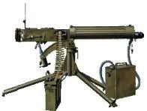
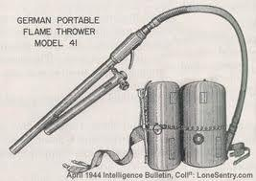
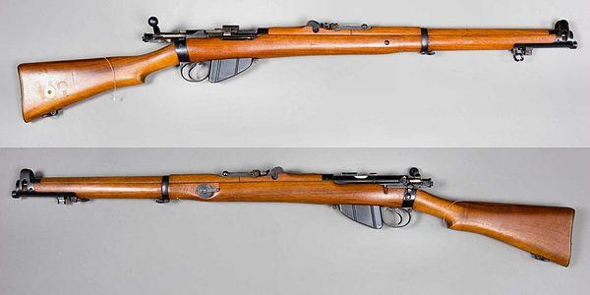
Although many new tactics and strategies were created during world war II, infantry were still the primary means of fighting.
Rifles
Machine guns
Flamethrowers
-Most common type of gun
-used by all countries
-Sniper rifles were also used to take out high value targets
-Used against other infantry
-Major upgrades since WWI
-Mostly used by Germany
-could project flames 32m
- used flush out enemy soldiers

Slide 3
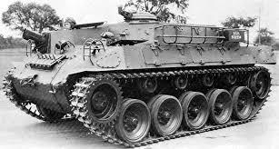
World War II was the first time that tanks were mass produced for war. They were used against machine guns to help prevent a mass slaughter.
-Used by all countries
-Used during German Blitzkrieg
-Provided protection from machine guns
-Used during ally invasion of europe on D-day

Slide 4
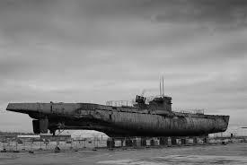
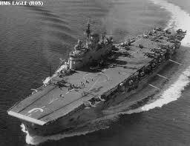
There was a lot fighting in the Atlantic during the war. The Germans were the kings of the sea for most of it up until the british were able to crack their code. After this the german submarines were no match for the giant battleships.
Submarines
Aircraft carriers
-Mostly used by Germany
-Difficult to track underwater
-Used to sink Canadian supplies
-Massive ships
-Used to transport aircrafts
-Able to launch and land aircrafts

Slide 5
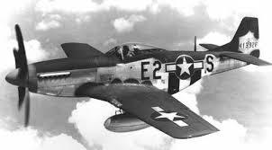
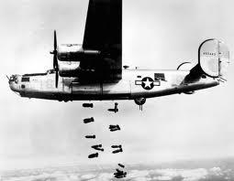
The roles of planes had completely changed since World War I. Instead of being used for reconnaissance they were now used for bombing and dog fighting.
Bombers
Fighter Planes
-Used by Allies and Axis
-Germany bombed Britain for 52 days in the Battle for Britain
-Canada’s air force was in charge of bombing germany near the end of the war.
-Used to take out enemy aircraft
-Japan used Kamikazes who were pilots that would crash the airplane into ally defences

Slide 6
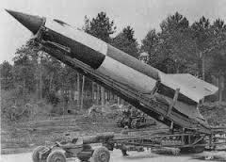
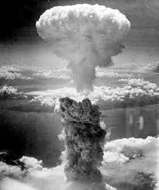
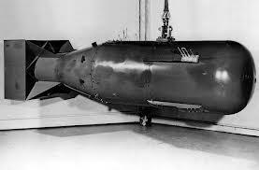
Lots of different bombs and missiles were used during the war. The most common were the atomic bombs dropped on Japan at the end of the war.
V-2 missile
Atomic Bombs
-Used by Germany
-Had a range of 350 KM
-Technology later used in the first rocket to the moon.
-U.S.A dropped 2 them on Japan to end WWII
-Named Fatman and Littleboy
-Caused lasting nuclear radiation in Japan

Slide 7
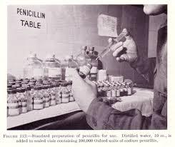
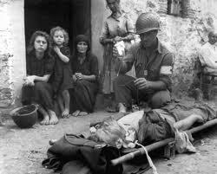
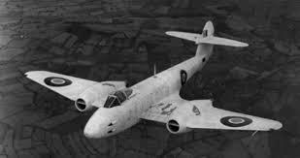
Not all the new technology developed was for killing people. Actually there was a lot of advancement in the medical field during this time as well as other fields.
Penicillin
Blood Transfusions
Jet Plane
-A antibiotic used to treat multiple diseases.
-First isolated during WWII
-Made easier to store blood for soldiers during the war
-First jet propelled planes became available
-Not used much in war

