Slide 1
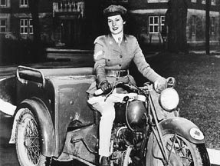
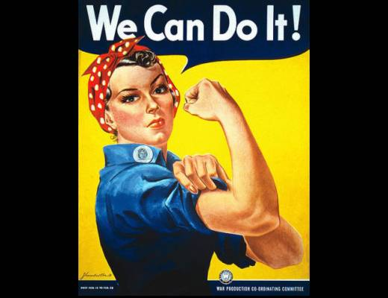
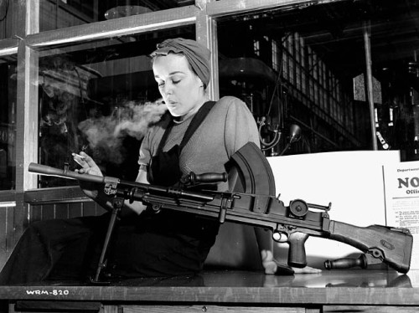
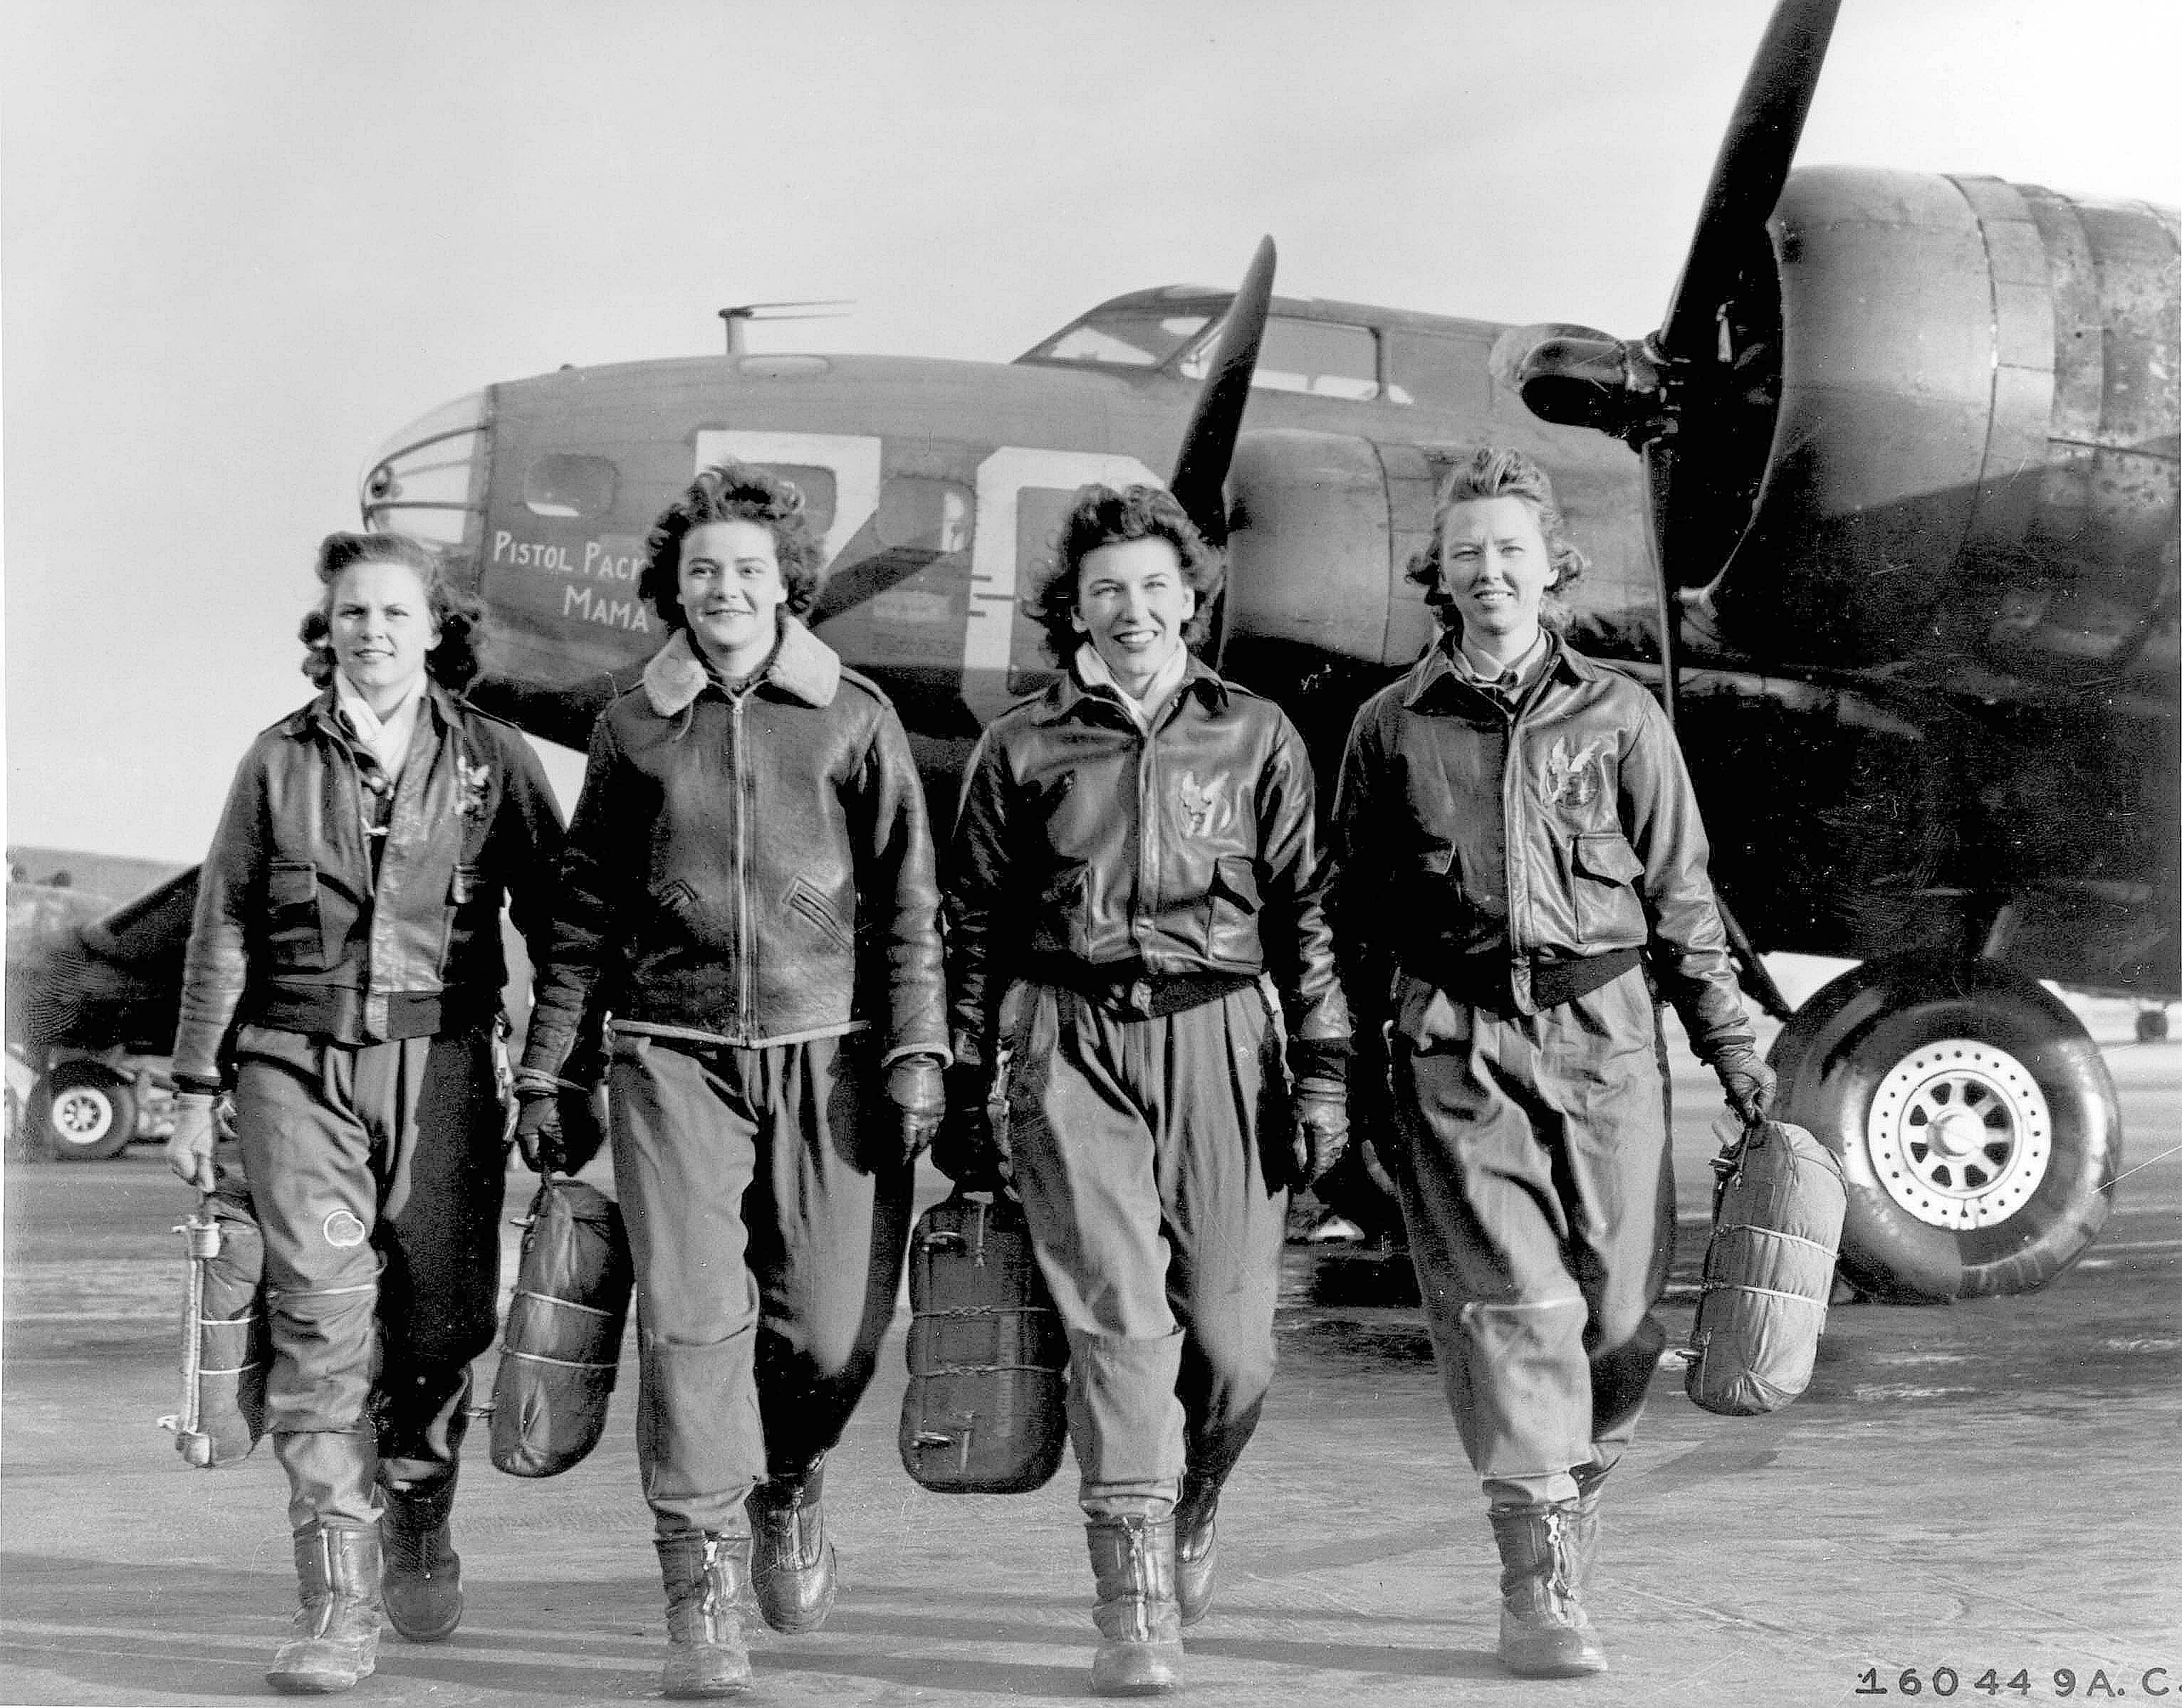
Women In WWII

Slide 2
War In The Air
The Women’s Division (WD) of the Royal Canadian Air Force (RCAF) was created in 1941.
Women trained as clerks, cooks, hospital assistants, drivers, telephone operators, welders, instrument mechanics, and engine mechanics.
The RCAF refused to let licensed female pilots fly until later in the war.
Women ferried bombers to Britain, but never took part in combat.

Slide 3
Women And The War Machine
As the First World War, women joined war industries in roles that were unusual for them at the time. “Rosie the Riveter” became a popular nickname for these working women.
During the war, the National Selective Service Program registered women for work in factories and established daycare centres in Ontario and Quebec, where industry was concentrated.
Women also joined the Canadian Women’s Army Corps (CWAC), serving mostly as clerks, drivers, and nurses.
By 1945, almost one-third of all Canadian women were employed in the war effort.

Slide 4
Women Over Seas
Early in the war, women were accepted into the armed services for the first time in Canadian history. In 1941, the Canadian Army created the Canadian Women’s Army Corps.
During the same year, the RCAF (Woman’s Division) was established, followed by the Women’s Royal Canadian Naval Service.
Overseas, women filled non-combative positions such as radio operators, first-aid workers, nurses, and ambulance drivers.
http://www.cbc.ca/player/Digital+Archives/War+and+Conflict/Second+World+War/Women+in+WWII/ID/1836346437/

Slide 5
Women On The Home Front
In 1942, the federal government established the National Selective Service (NSS) to recruit as many women as possible for wartime work.
As a result, thousands of women worked in war industries building ships, airplanes, and weapons.
In rural areas women operated farms, and across the country they filled a variety of positions traditionally held by men.

Slide 6
Fin

