Slide 1
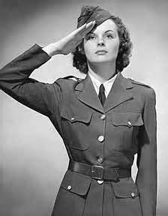
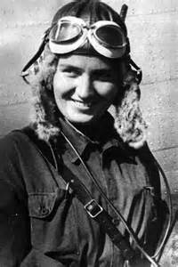
Woman’s Contribution
How woman helped with the war
- Early in the war woman were accepted into the armed forces and worked mostly on the home front.
- The NSS (National Selective Service) was recruiting woman and over 43,000 were serving.
- The woman on the home front took over men’s jobs such as working in the war industries and farming.
Where the woman helped
- Most women stayed on the home front in Canada doing the necessary jobs for the war.
- Many women went overseas and worked non-combative jobs like radio operators, first-aid workers, nurses and ambulance drivers.
When the woman contributed
- In 1941 the Canadian Army created the Canadian Women’s Army Corps and women were allowed to join the war effort overseas.
- The NSS was recruiting women by 1942
- By 1945 thousands of women were overseas contributing.
Women’s significance to Canada
-They were eager to support the war effort
- Men needed their help with the war working their home jobs and
in the navy.
Interesting facts
- Almost 4,500 joined Canadians Nursing Services
- Over 20,000 jointed the Canadian Women’s Army Corps
- Over 16,000 joined the Women’s Auxiliary Air Force
- Over 6,660 joined the Women’s Royal Naval Services

