Slide 1


WEAPONS
AND TECHNOLOGY
OF WORLD WAR 2
By Gavin Pattman

Slide 2
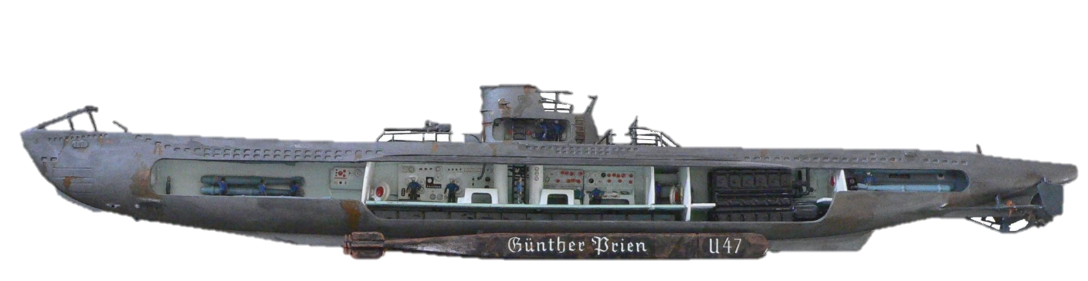
Submarines
WHO: Axis and Allied Powers, especially Germany
WHAT: Upgraded version of the World War 1 “U-Boat”
-Could travel underwater for limited amounts of time to avoid being seen
-Attacked using torpedoes, which were underwater missiles
-German submarines sunk many Canadian ships, especially those carrying supplies overseas

Slide 3

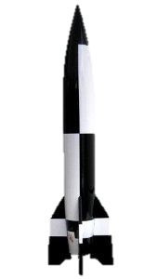
V-2 Rockets
WHO: Nazi Germany
WHAT: First long-range ballistic rocket, invented by Germany to retaliate against the Allies bombing their cities.
-Had a range of 320 kilometers
-Inventors of the V-2 moved to the US after the war and designed the rockets that would land man on the moon
-These rockets were used against Canada’s main ally, Britain, near the end of the war.

Slide 4
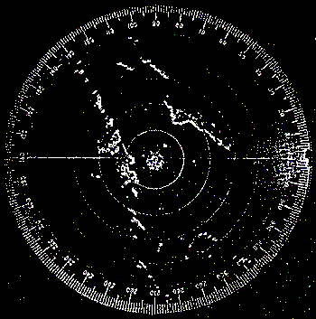
Radar
WHO: Axis and Allied powers
WHAT: Systems that used radio waves to detect incoming aircraft from extremely long distances
-Used to prepare and defend against aerial attacks
-Canada had extensive involvement with radar systems, more than any other commonwealth nation.

Slide 5
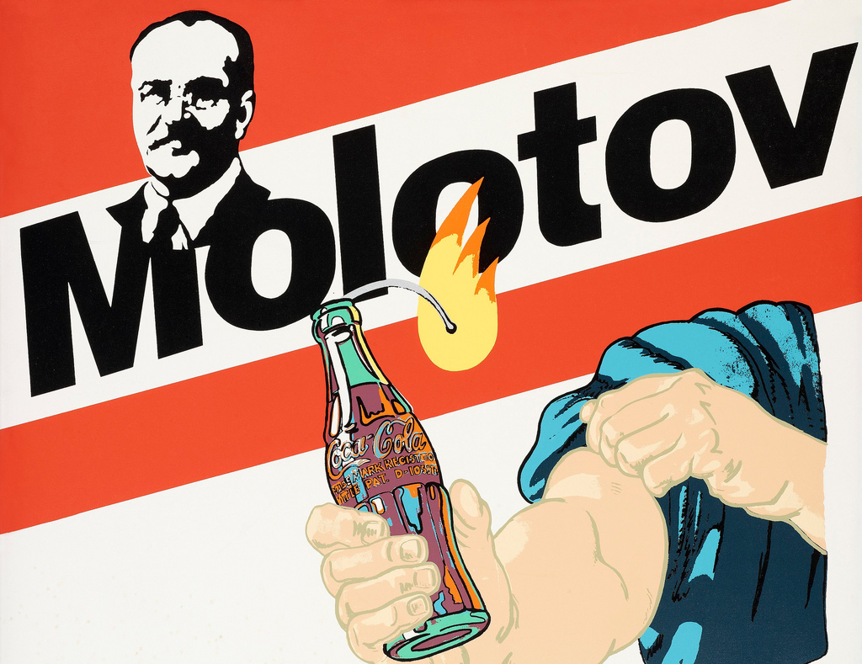
Molotov Cocktail
Cocktails
WHO: Mostly Allied forces
WHAT: Petrol-filled glass bottle, usually with a
cloth wick at the end. Used as an improvised firebomb.
-Though used in the Spanish Civil War, they were popularized (and named) during the Second World War by the Finnish.
-Often used by Allied forces (including Canadians) to disable tanks as they were easy to produce and find the materials to make.

Slide 6
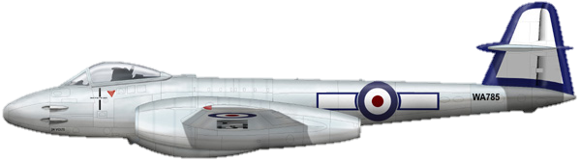
Jets
WHO: Allies and Axis powers.
WHAT: Planes with jet engines that could fly higher and faster than the propeller aircraft that were being used
-First used in World War 2
-Though both sides of the war scrambled to produce as many jets as they could, very few jets were made before 1944 (one year before the war ended)
-Jets changed aerial combat immensely, but Canada never produced them.

Slide 7
Ironically, though WW2 ended millions of lives, some of the greatest advances in medical science were developed during the war
(as doctors were trying to put injured soldiers and civilians back together).
These techniques were used to treat many Canadian soldiers and by Canadian medical personnel.
Medical
Advancements

Slide 8
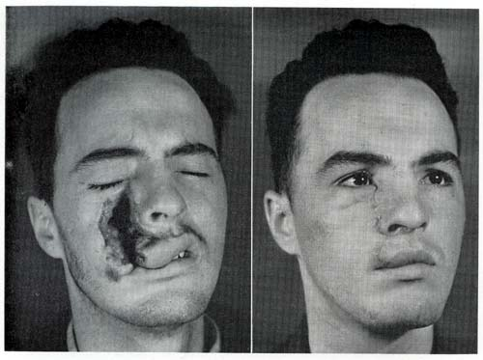
SKIN GRAFTS:
A gifted plastic surgeon working for the Royal Air Force discovered new ways of treating pilots with severe burns, advancing burn treatment and skin grafting methods immensely.
Medical
Advancements
(Least disturbing picture I could find; never look up WW2 skin grafts on google images)

Slide 9
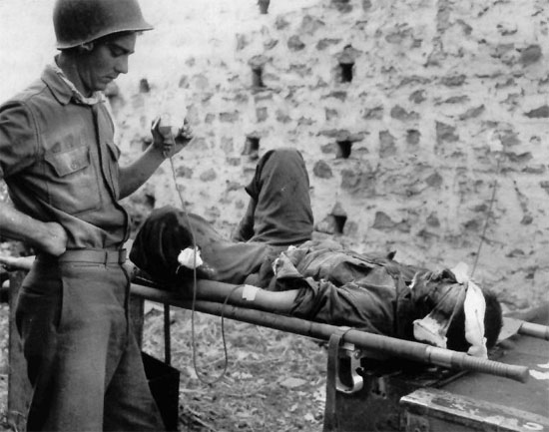
Blood Transfusions:
Methods for storing blood for transfusions become much more effective, allowing many more wounded soldiers and civilians to receive blood transfusions.
Medical
Advancements

Slide 10
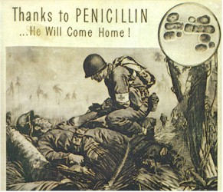
Penicillin:
This antibiotic was developed just before and during the war, and was used to treat infections very effectively. Variations of it are still being used today to neutralize harmful bacteria.
Medical
Advancements

Slide 11
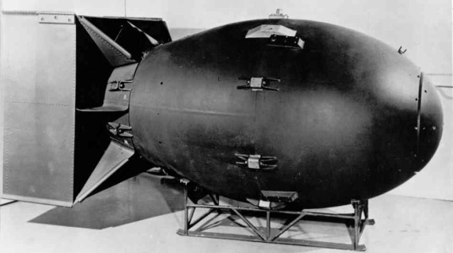
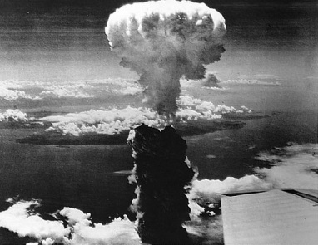
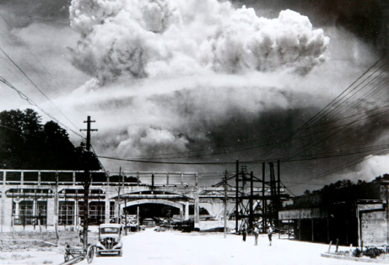
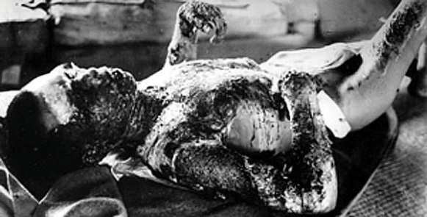
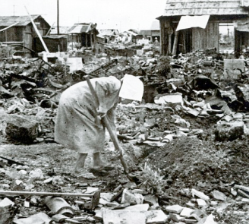
Atom Bomb
WHO: The United States of America
WHAT: Explosive devices (bombs) that used nuclear fission (breaking the nucleus of an atom) to produce massive explosions.
-Each bomb was capable of wiping out entire cities
-Little Boy was dropped on Hiroshima in August, 1945
-Fat Man was dropped on Nagasaki soon after, bringing the death toll to over 100,000 people (mostly civilians, including families and children)and injuring a 100,000 more.
-The dropping of these two bombs basically ended World War 2,as Japan surrendered soon after.

