Slide 1
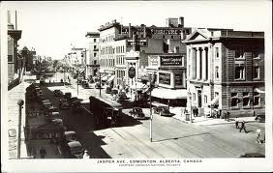

Slide 2
ECONOMIC EFFORTS

Slide 3
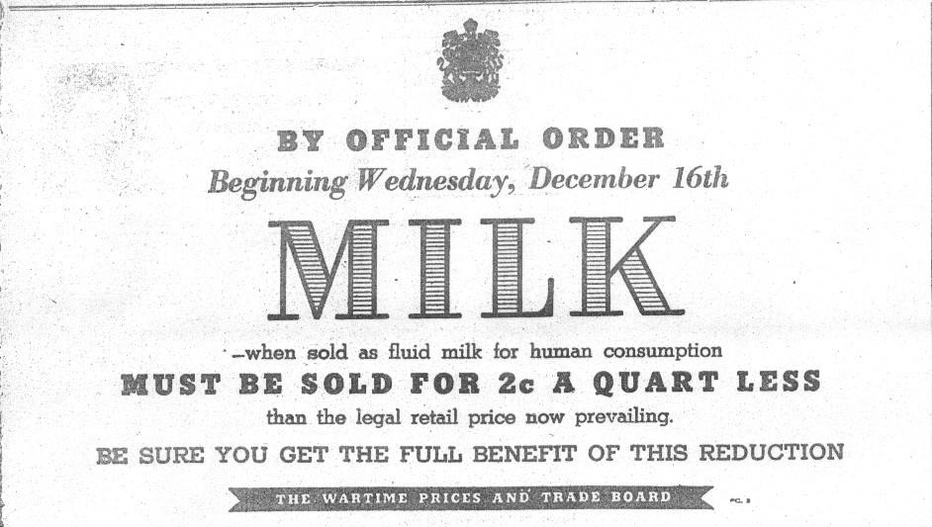
Wartime Prices & Trade Board
•The W.P.T.B. was set up in October 1939 in order to avoid conditions of inflation and social conflicts as seen in the First World War.
•This was established by Prime Minister Mackenzie King.
•In 1941, wages and prices on all goods were frozen.

Slide 4
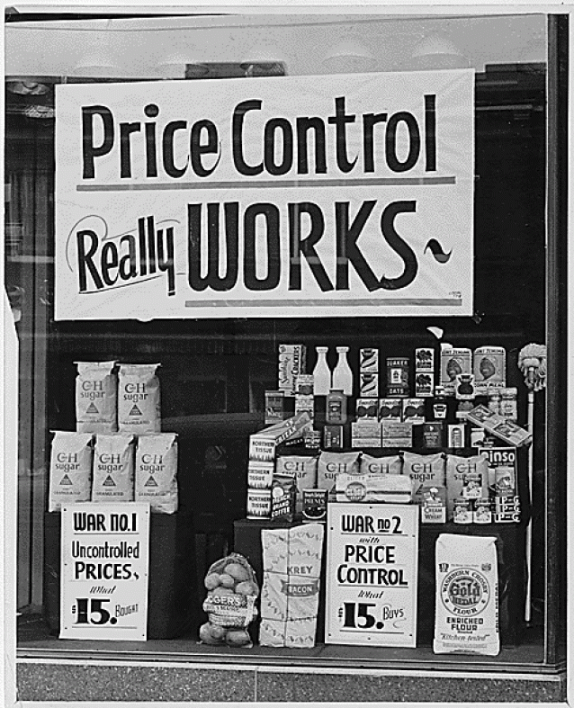
Wage and Price Controls
• Measures taken by the government under its income policies to control wages in an attempt to check cost-push inflation and wage-push inflation. • Dec. 1940, the Canadian government began to take full control of the economy. - Wage and Price Controls was initiated, regulating the wages of workers and limiting increases in the prices of goods and services. - This also included priced on rent, lumber, sugar, milk. •Despite this, prices still continued to rise.

Slide 5
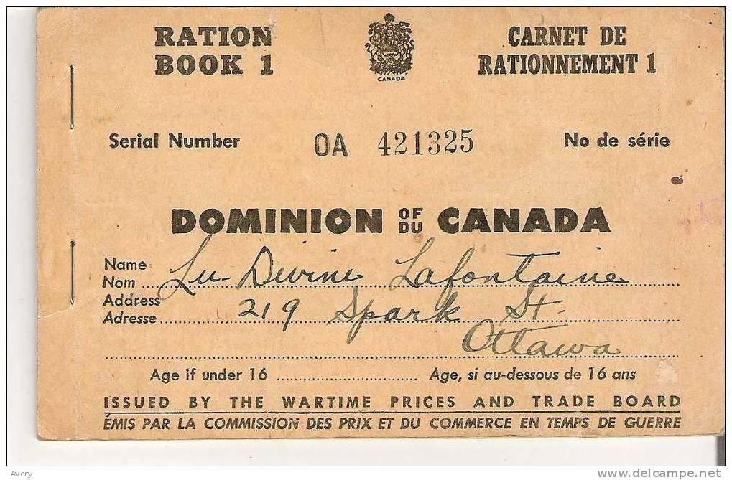
Food Rationing & Victory Bonds
•Food rationing was implemented in 1941. Every Canadian citizen was given a ration book which set the limits on the amount of coffee, tea, jam, butter, milk, and meat that they were allowed. - In 1942, sugar rationing coupons were introduced. •Victory Bonds were a way for people to invest money into the war. When the war was over, people could cash in their victory bonds for a profit.

Slide 6
SOCIAL EFFORTS

Slide 7
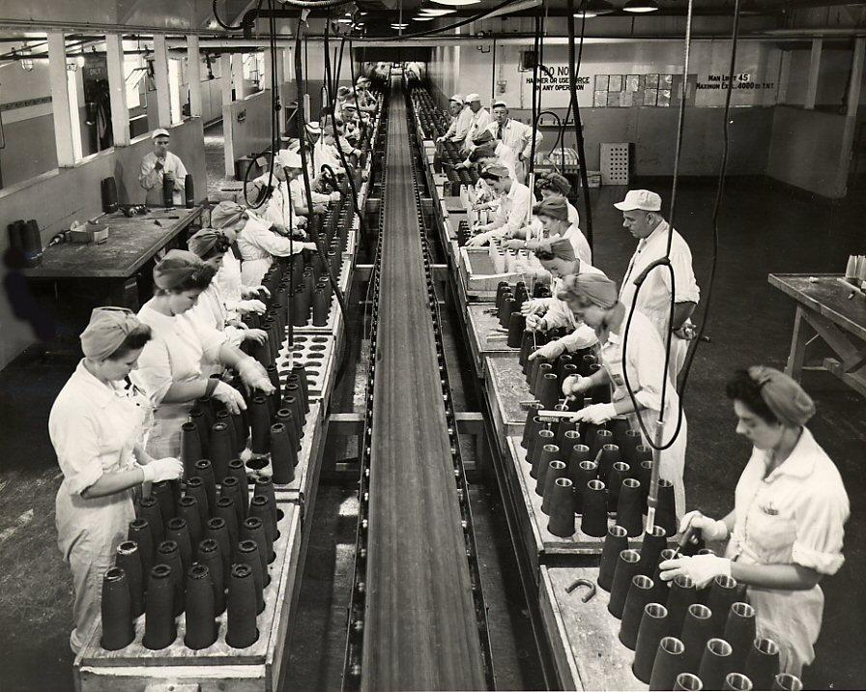
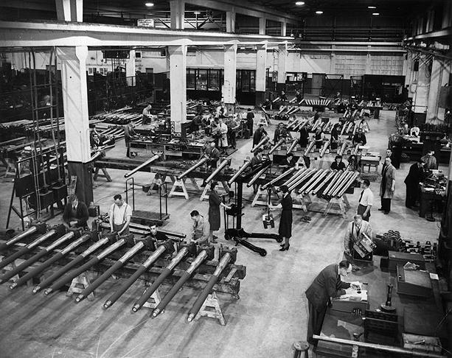
Weapons and Munitions Factories
•The opening of factories in Canada allowed the unemployment rate to drop drastically. •With most of the men overseas, women also worked in the factories. This helped raise the income of families as a whole.

Slide 8
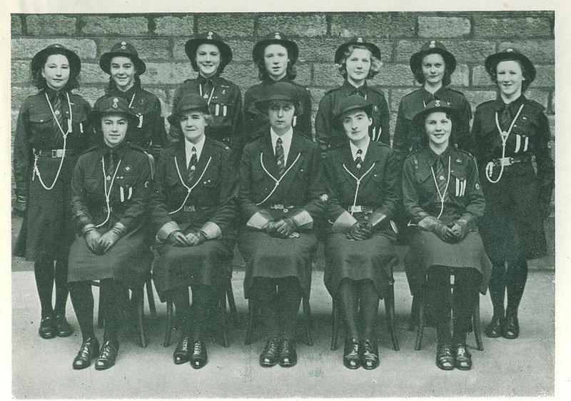
Social Programs
• Girl Guides, Boy Scouts, and other community organizations would collect recyclables such as steel, aluminum, and copper for military projects and weapons manufacturing.

Slide 9
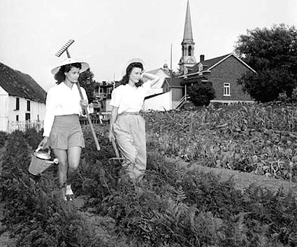
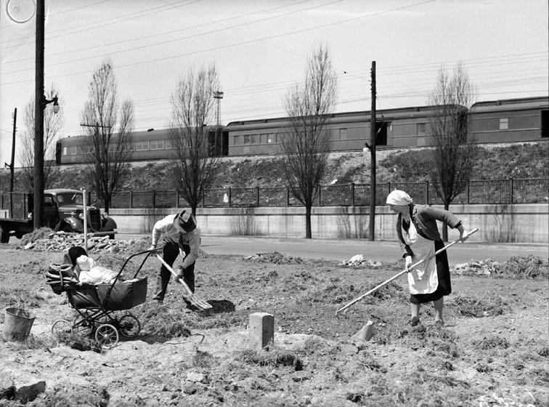
Victory Gardens
•Set up to increase food production during the war.
•There were 209,200 Victory Gardens in Canada in 1943 that on average produced 250 kg of vegetables each.

Slide 10
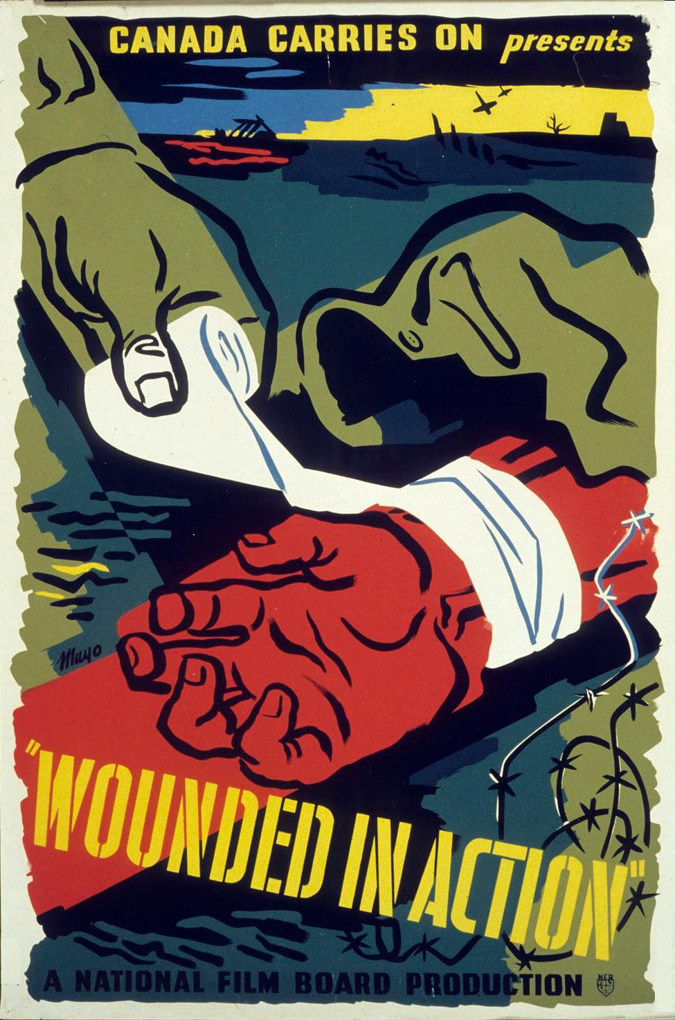
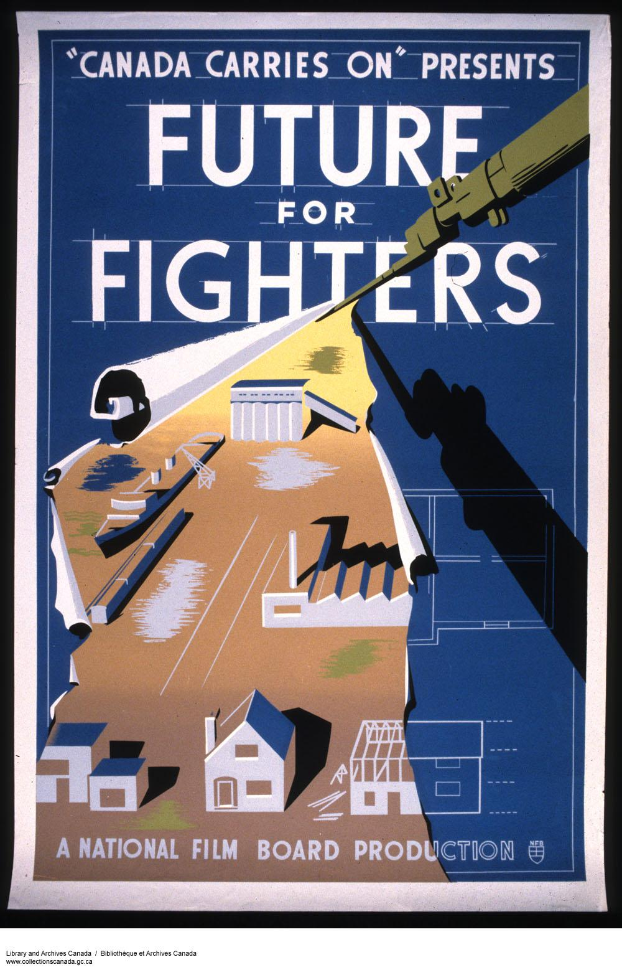
National Film Board
•Created in 1939, the National Film Board formed hundreds of documentaries and short films during the war. Each one designed to make Canadian civilians feel like they were part of the war effort.
•The NFB’s most influential work was the series Canada Carries On.

Slide 11
POLITICAL EFFORTS

Slide 12
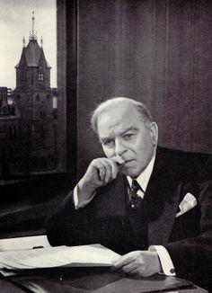
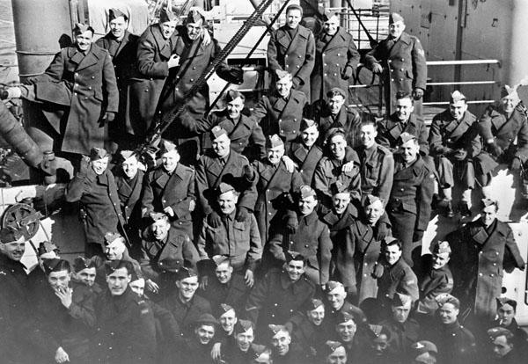
Unemployment Insurance
•Created in 1940 by Prime Minister Mackenzie King •Set up as a source of income for veterans who could not find or return to their job once the war was over.

Slide 13
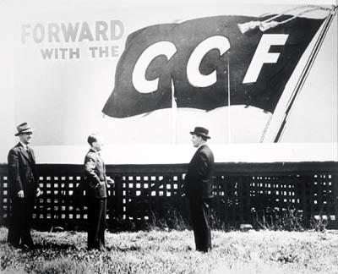
The Co-operative Commonwealth
Federation
•During the war, the CCF gained popularity both nationally and provincially. •In 1943, the CCF made up the Opposition in Ontario and in 1944, it formed the provincial government of Saskatchewan under the power of T.C. “Tommy” Douglas.

Slide 14
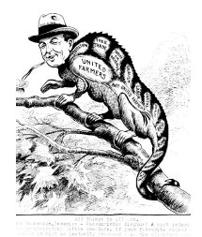
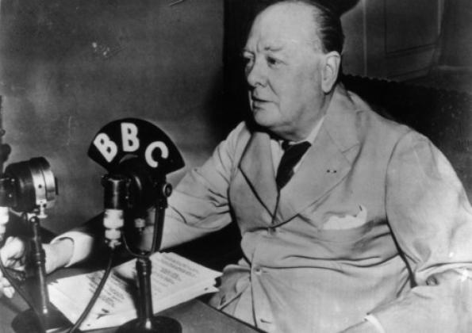
“Cradle To Grave” Social Security
•In 1945, T.C. “Tommy” Douglas expanded Canada’s social assistance further by bringing in the Family Allowance program which helped families cover costs of child maintenance. •Social assistance was now provided by the government from birth to death.

Slide 15
The Conscription Crisis
•Prime Minister Mackenzie King promised there to be no conscription when Canada declared war in 1939, but it soon became clear thousands of soldiers would be needed in order to fight the Nazis.
• In response to Canadian demands that the government do more for the war effort, King introduced the National Resources Mobilization Act which gave the government emergency powers to take over the nation’s resources.
•In 1942, the act was altered to allow conscription although only for home defence.

Slide 16
The Vote on Conscription
•The Conservatives continuously pressured Mackenzie King to bring in conscription. King held a plebiscite on the issue, asking Canadians if they would release the government from their promise to not send conscripts overseas. All provinces but Quebec had a majority vote of “yes”, and conscription, once again, divided the nation.
• Many Quebecois felt betrayed by King’s actions and riots broke out in Montreal, protesting his decision.
• In 1944, Mackenzie King conscripted 15 000 men overseas under the NRMA.

