Slide 1
The Reign of Terror
1793-1795

Slide 2
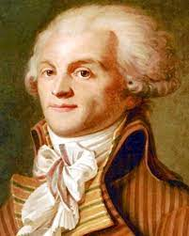
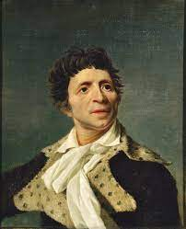
In 1793 after the death of Louis the 16th, The Jacobins (lead by Robespierre) and Sans Culottes (lead by Marat) took over the National Assembly (which changed its name to the national convention). They were determined that the advances made by the Revolution would not be reversed.

Slide 3
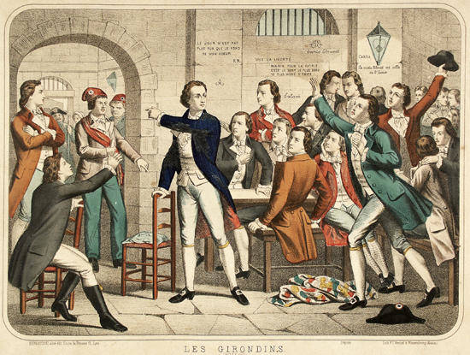
They began to attack the Girondists (moderates).

Slide 4
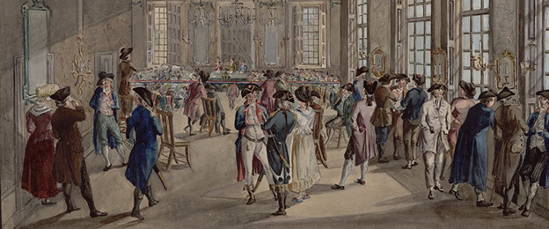
A group was established called “The Committee of Public Safety” whose job it was to find anyone and anything against the revolution/republic.

Slide 5
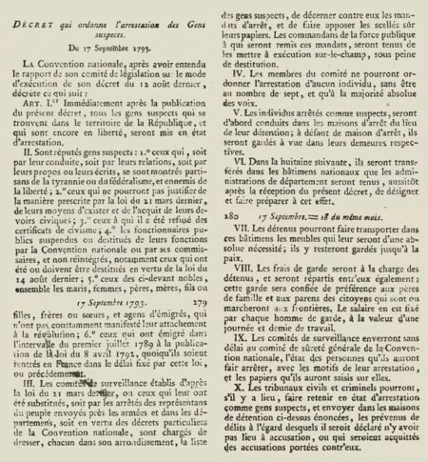
They passed the “Law of Suspects” which allowed them to put on trial and kill anyone suspected of being against the republic/or hoarding food/or being nobles
Became like a witch hunt, a way to get rid of your neighbors. You could be denounced for hoarding bread, raising bread prices, using titles, supporting the nobility, supporting the Catholic Church

Slide 6
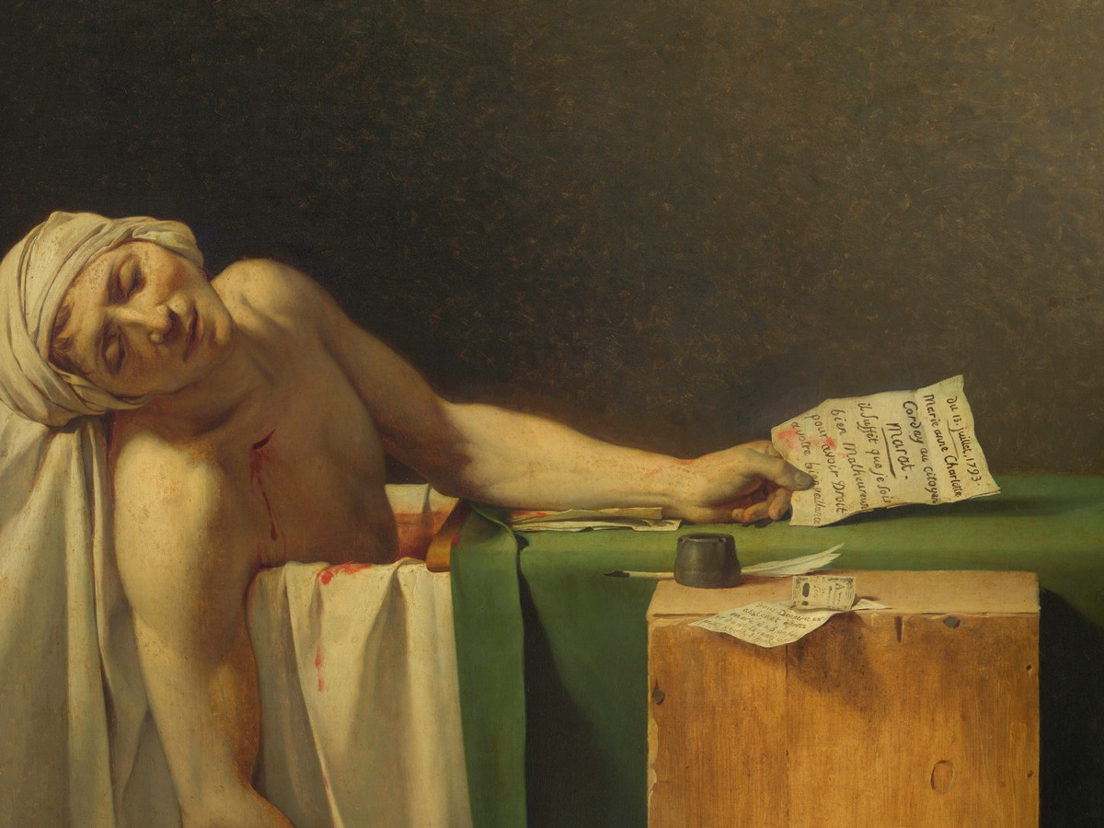
Marat was murdered by a Charlotte Corday (Girondist)

Slide 7
Made many radical changes to France now that Robespierre has all the power:
1. Metric system introduces
2. new calendar based on seasons and
metric system
3. ended slavery
4. Put through a law for free schools and universal suffrage
5. Reorganized army based on merit, not noble birth
6. Banned Catholic Church, introduces Enlightened Church of Reason

Slide 8
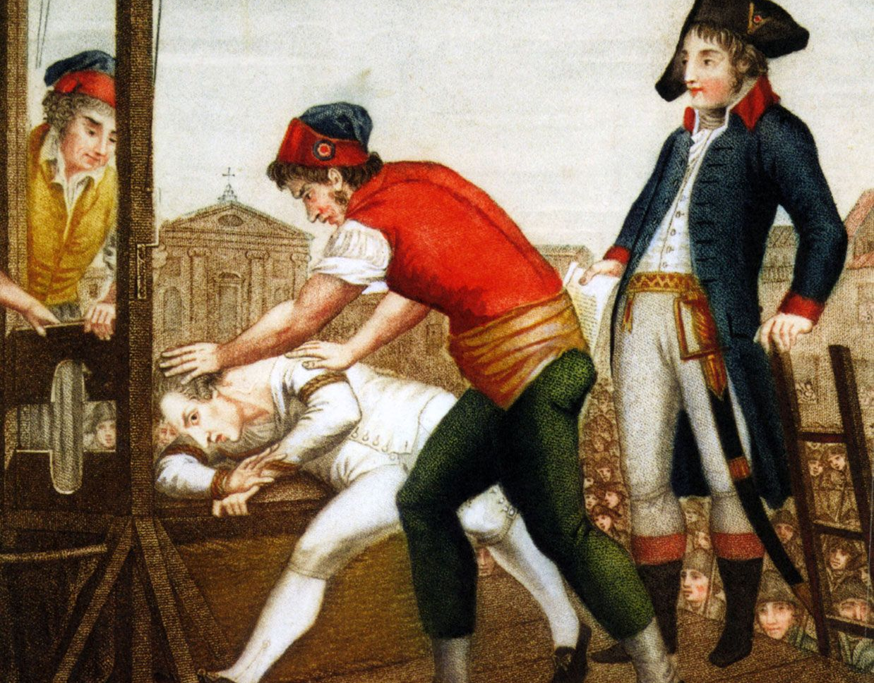
Soon the Terror turned on its leader: Robespierre was guillotined (who had already killed Danton)

Slide 9
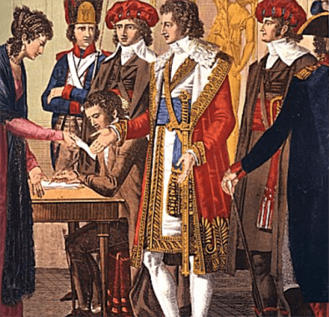
A government called the Directory took over; run by three people (to avoid dictatorship).

Slide 10
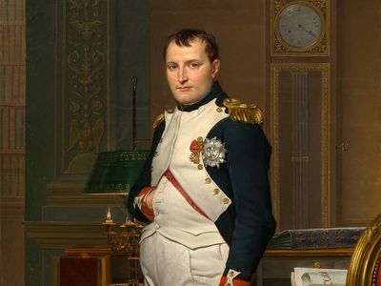
A General named Napoleon soon crushed the weak Directory

