Slide 1
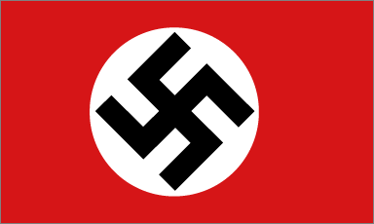
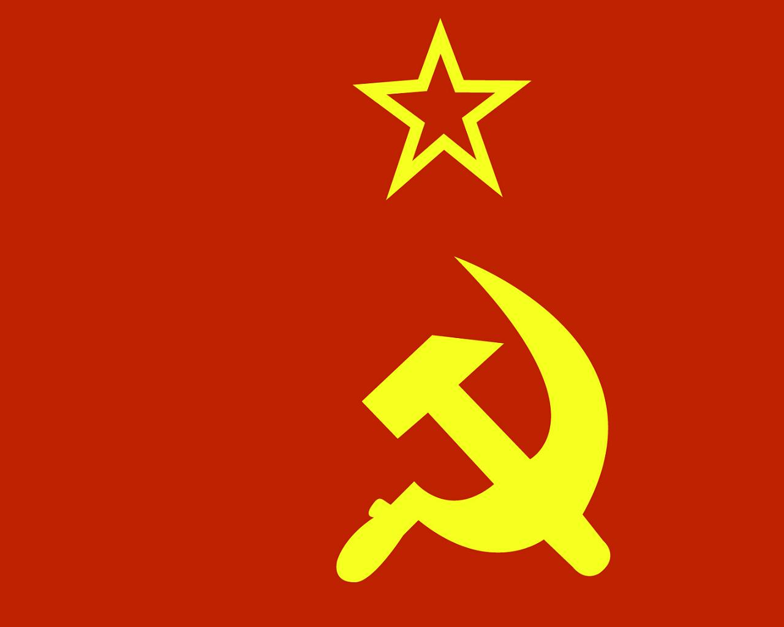
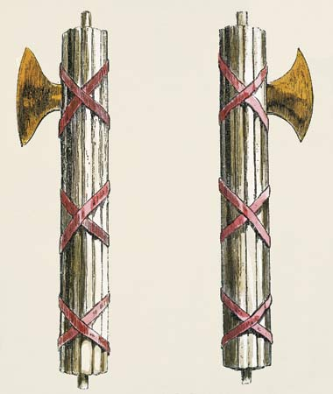
The Road to War
Rise of the totalitarian
governments of the
1930s

Slide 2
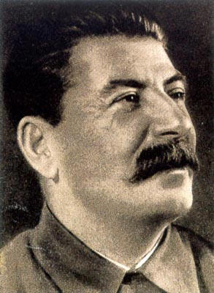
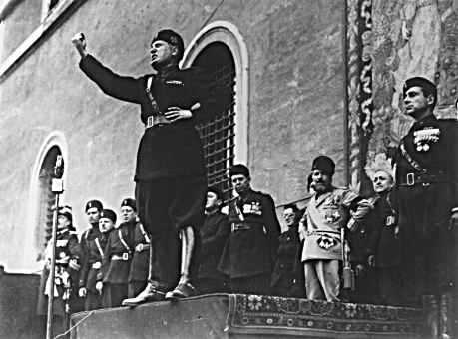
The Key Players
Josef Stalin (Uncle Joe)
Communist Party 1923-1953
Il Duce: Benito Mussolini
Fascist Party (Blackshirts) 1922-1944

Slide 3
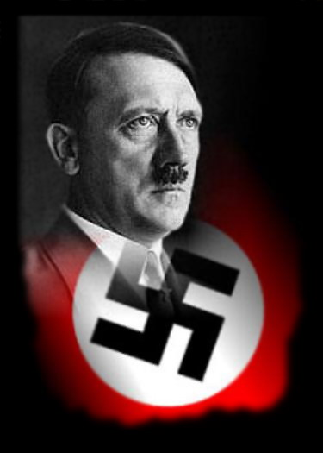
Adolf Hitler (nee Schickelgruber)
NSDAP (Nazi Party)
1933-1945
Don’t write this down
Blinded near the of the war
Homeless vagrant in the 1920s,
survived by painting Postcards.
Rejected from art school twice
Elected to power (as Chancellor) in Jan. 1933
Seized 1934.

Slide 4
So what did they have in common? (Beside lack of height….)
Authoritarian Governments: Strong leader(s) control ALL aspects of Citizen’s lives. Rule with an Iron Fist (Ie: Leisure time, Religion, Political Views)
Why did countries turn to authoritarianism? In times of chaos, People want to see return of order.

Slide 5
How was Hitler able to be elected?
Germany is upset after WWI, resent the Treaty of Versailles, particularly reparations and the war guilt clause
What did he promise Germany?
-Overturn Treaty
-Fix Currency (12 billion marks=1 Canadian $)
-Rebuild farms
-Put people back to work
-Put money into public works
-Restore German pride

Slide 6
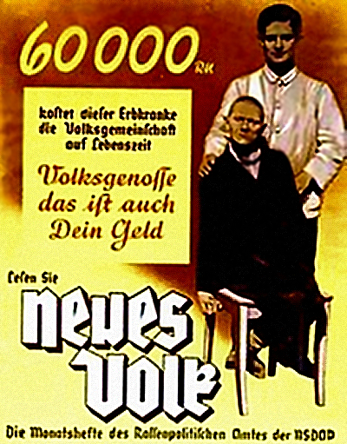
Who did Hitler Blame for Germany’s Problems?
Needs a Scapegoats for Germany’s problems.
Chooses:
Jews
Homosexuals
Communists
Mentally Challenged
Gypsies
Socialists

Slide 7
The Road to War
March 7, 1936 Re-militarization of the Rhineland, the allies do nothing
Spanish Civil War, 1936, chance to try weapons, tactics
March 1938, anschluss with Austria
1938 Sudeten Crisis, allies negotiate with Hitler (basically they give him what he wants)

Slide 8
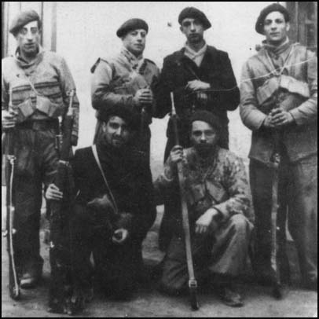
Spanish Civil War 1936
Who: Elected Socialists vs. Fascists
(with help from Germany and Italy)
Main Points/Relevant Details:
-First use of Tanks/Aircraft (first use together)
-Socialists + International Brigades Vs Fascists + Grm/Italy
-“Mackenzie-Papineau” (Canada) International Brigades join
-Francisco Franco = leader of fascists

Slide 9
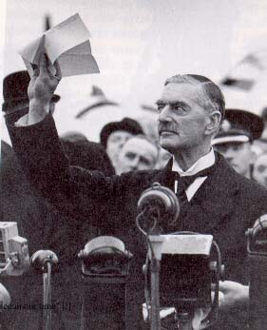
Appeasement
1938
Britain and France vs. Germany
Hitler wants to annex the Sudetenland
-France/Britain give Hitler what he wants to avoid going to war.
-Casualties of WW1 still on mind
British PM Neville Chamberlin negotiates with Hitler, believed he has achieved “peace in our time”
Outcome:
-Hitler takes Czechoslovakia in 1938.
-Invades Poland in 1939.
-WW2 starts

Slide 10
Canada’s Response to Growing Tensions
Isolationists: uninterested in anything going on outside of Canada
Why? Major Causalities in WWI, in midst of Great Depression

Slide 11
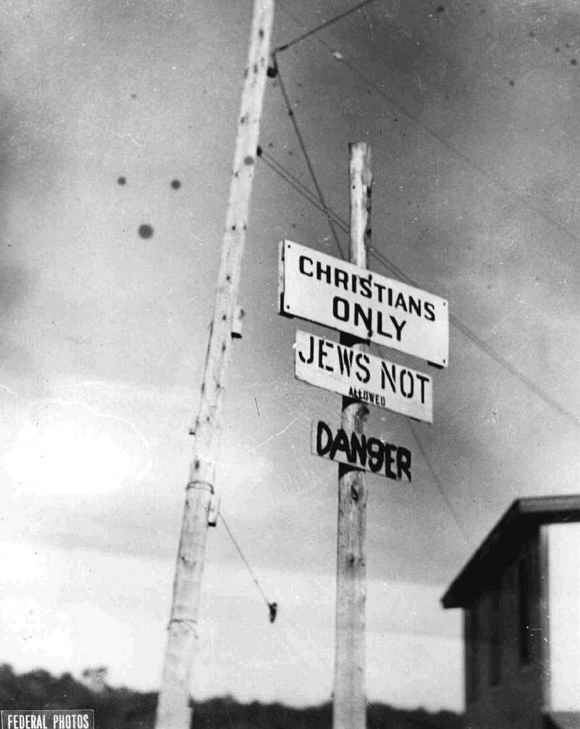
Mackenzie King Meets Hitler
First Impressions:
“He was the sort who truly loved his fellow man” – Likes Hitler a lot.
What does he have in common
with Hitler?
-Both are anti-Semitic.

Slide 12
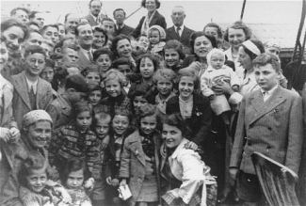
The SS St. Louis
“None is too many” immigration policy.
900 Jewish Refugees ask for permission to dock in Canada
Forced back to Europe
Most on board die in Concentration Camps

