Slide 1
Poverty
A slideshow of living conditions in some of the poorest countries in the world: Cambodia, Ecuador, Kenya and Morocco
(Pictures/explanations courtesy of Mrs. Hopp)

Slide 2
Cambodia
A fishing village called Chhong Khneas. This is a temporary village, since the entire area floods during the rainy season. The people who live here eat, drink and use the same brown water as a bathroom. Apparently if you manage to survive the first year of your life here, you're pretty much good to go for the rest of your life. The people living in this village fish on the large inland lake in Cambodia, and collect snails, which are considered a delicacy in nearby countries.

Slide 3
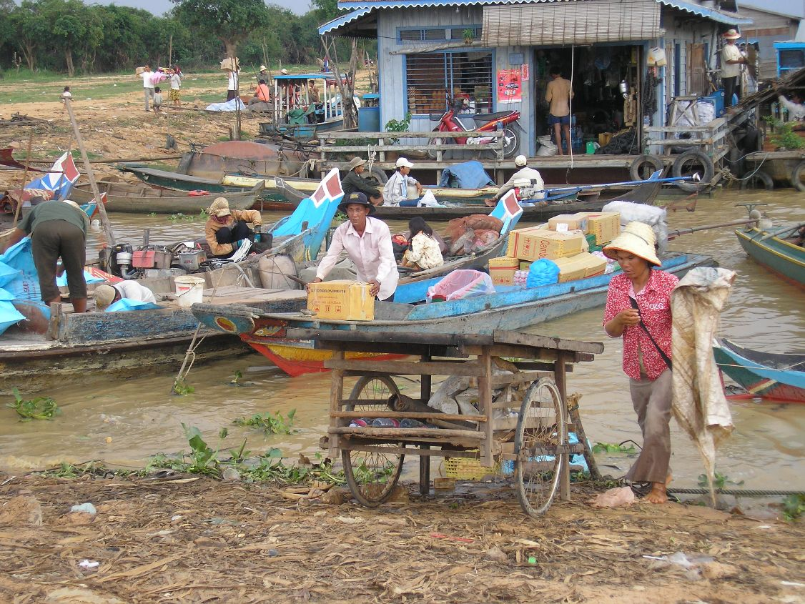

Slide 4
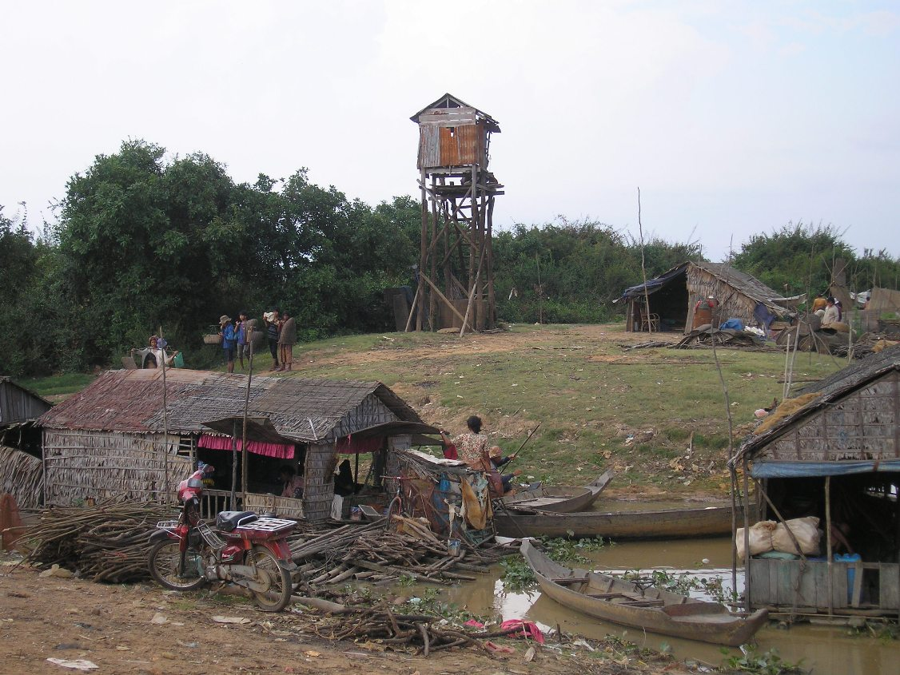

Slide 5
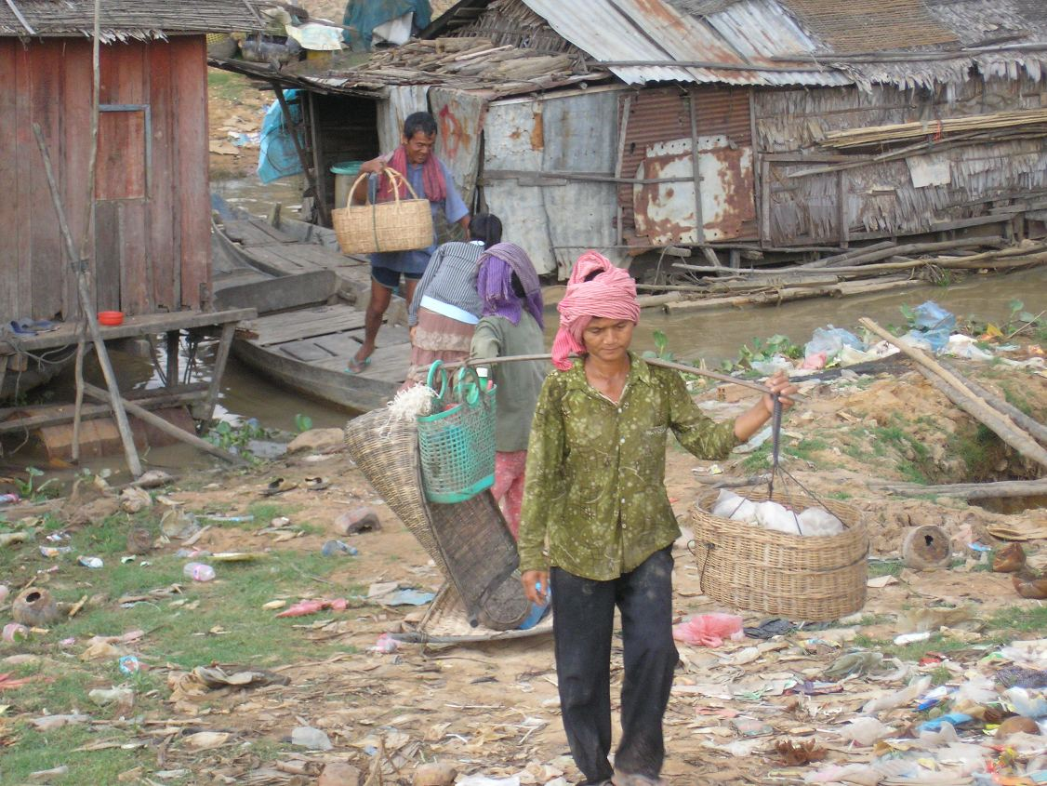

Slide 6
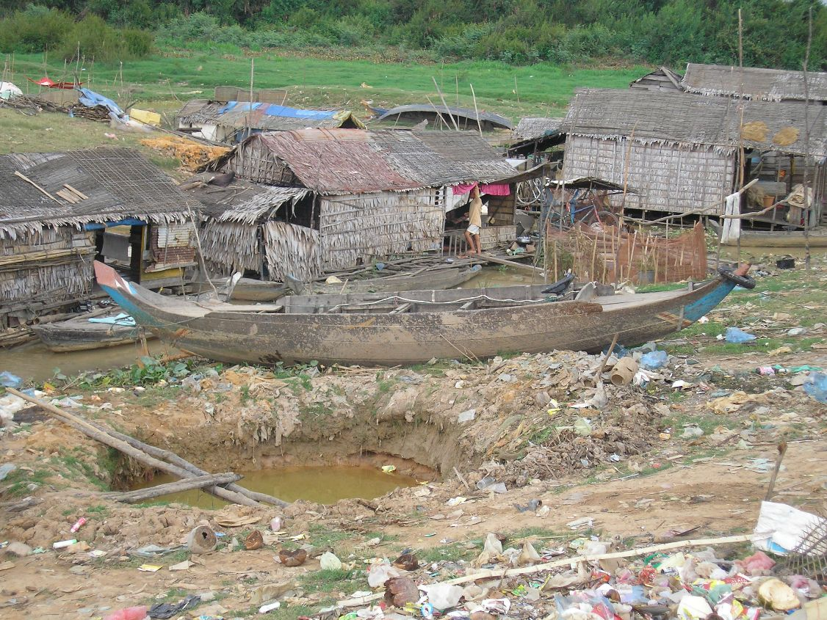

Slide 7
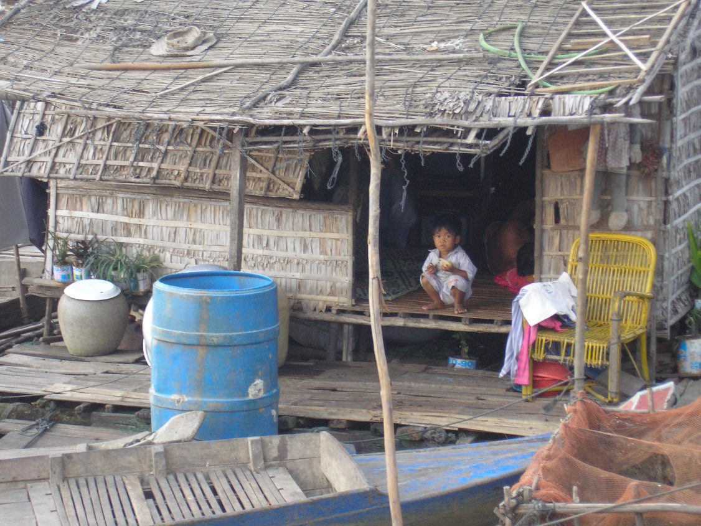

Slide 8
Remote fishing village on the Tonle Sap (Tonlay Sap) lake called Kampong Phhloc (Kampung Pluck).
This is a permanent village, which still floods in the rainy season, so everything is built on stilts. This is the school house in the village. Multiple grades are in the same room, and kids go to school only half the day because the school is not big enough to have room for all of the kids for a full day. Education is free in Cambodia, but you still have to be able to buy your uniform and books/supplies, which makes the cost of education prohibitive for many of the poorest people. This village is partially supported by a program that brings in western tourists, so they are better-off than most. We had a private guide take us there. The people live via traditional net-fishing techniques.

Slide 9
Ecuador
Poor people begging outside a local cathedral, or trying to sell what little they have (sometimes cold drinks served in plastic bags). There is no old-age pension system in Ecuador (or in many other countries), so when you get old, if you have no family to take care of you, you generally beg for a living.

Slide 10
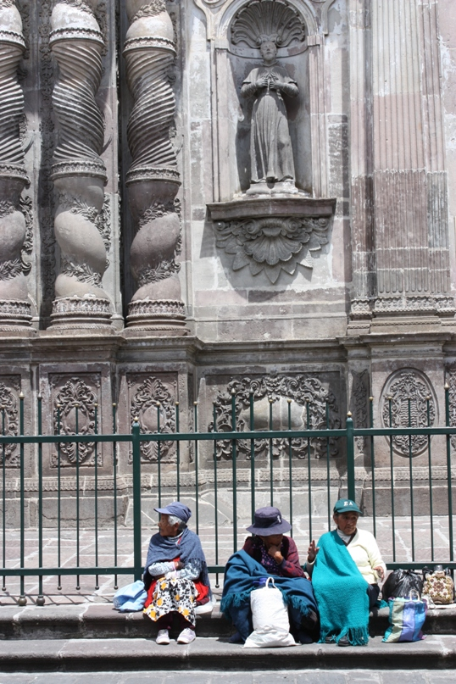
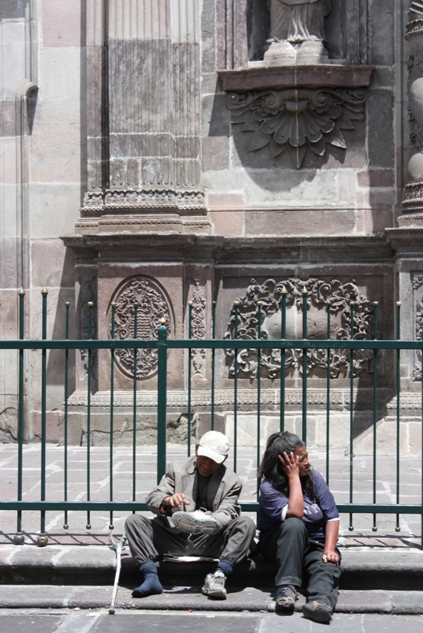

Slide 11
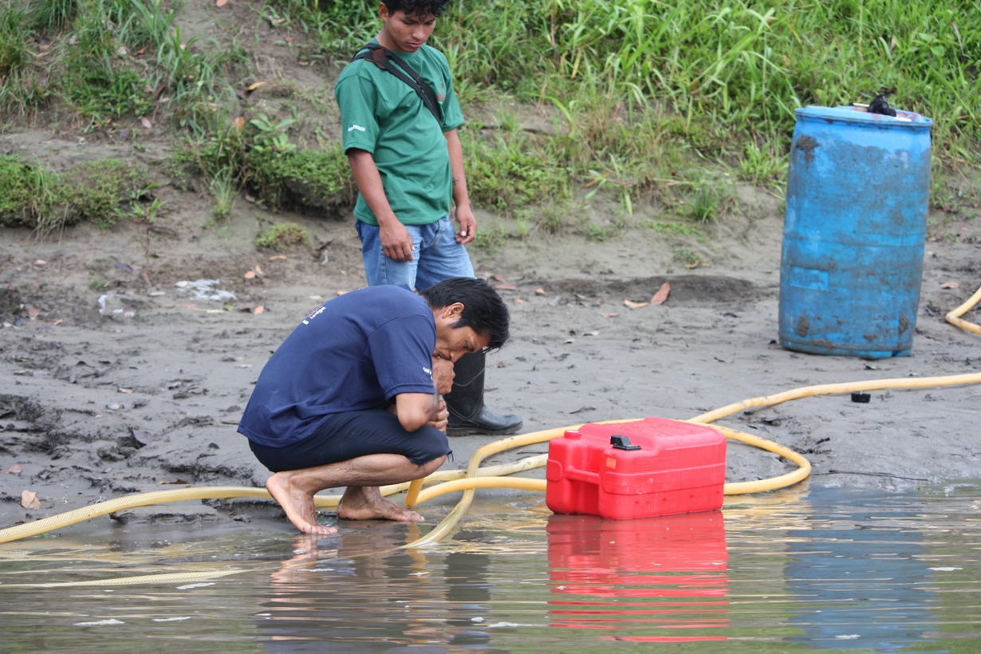
Hazards of the job - siphoning gasoline by mouth to fill up a boat's gas tank. A lot of gas also was spilled into the river in the process.

Slide 12
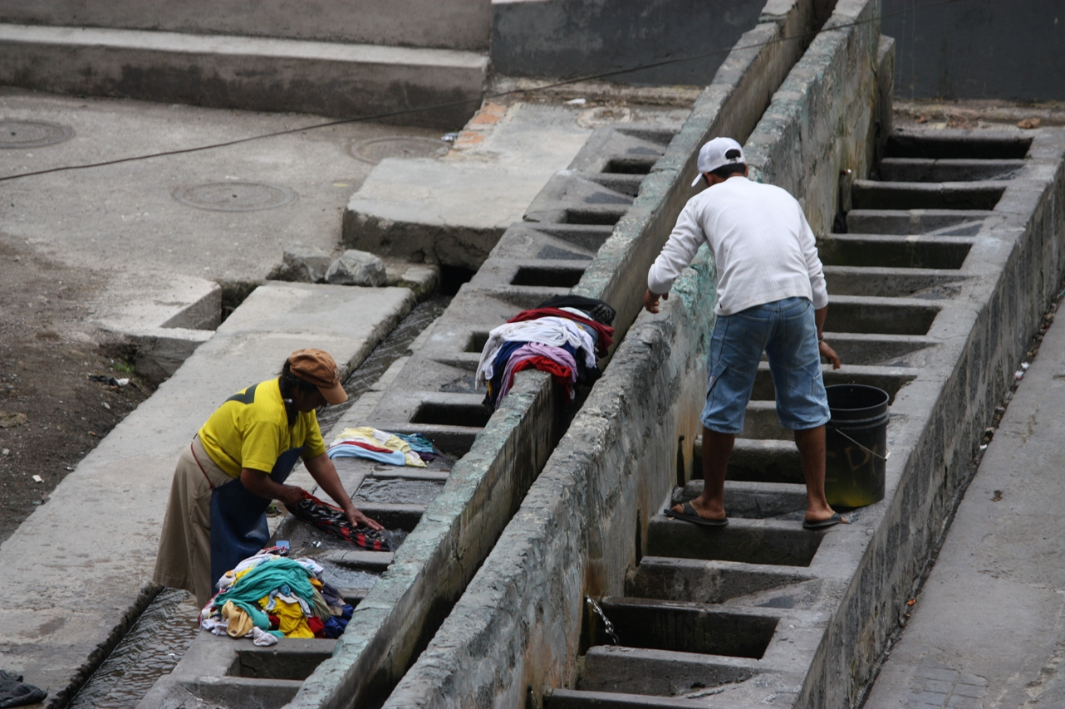
Local townspeople in Banos (Ban-yos) doing laundry at the waterfalls. The falls are partially diverted into these cement "sinks", where people can come and do their laundry using old-fashioned washboards.

Slide 13
Kenya
Boys at the Emmanuel Boys Rescue Centre, just outside of Nairobi. There are an estimates 60 000 street kids in Nairobi, either abandoned by parents who couldn't look after them, or AIDS orphans. These boys sleep 20 to a room at the Rescue Centre, get 3 meals a day, and get to go to school. If they have HIV, they get medication. They live in the compound you can see behind them, do their own laundry by hand and hang it to dry, raise chickens/vegetables for food and have to help cook and clean in the compound. Their clothes are donated and most have nothing in the way of personal possessions. (One boy was incredibly happy to have a wedding picture of me and my husband that I'd brought along.) They eat meat about once a month, as it is too expensive for the Centre to afford. When we went there, we bought a goat, which they slaughtered and cooked over an open fire...it was a feast for them. Usually they eat rice, ugali (maize porridge), some veggies and occasionally eggs.

Slide 14
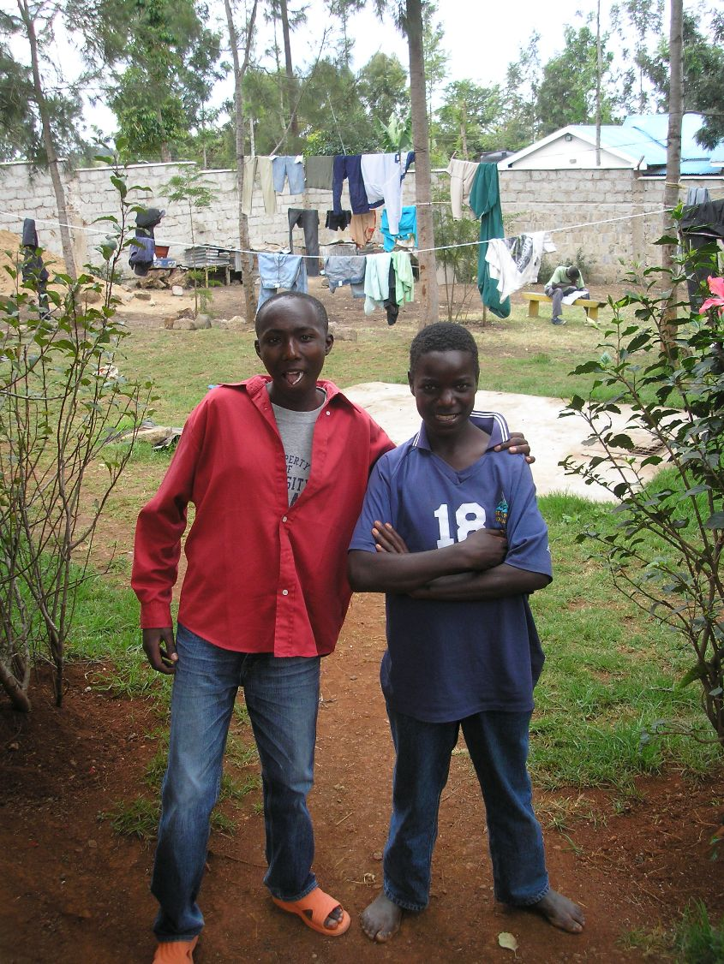

Slide 15
Maasai village boys.
No electricity, everyone lives in mud huts. This is a traditional lifestyle and no one thinks of themselves as "poor" here. Open wounds, flies, infections, runny noses, etc. are a way of life. You often see things like club feet and cleft palates that would normally be corrected by surgery shortly after birth here, but they are not corrected there.

Slide 16
Hazards of the job in Kenya.
This is a road crew, fixing the highway. This highway is equivalent in Kenya to what the Trans-Canada would be here.

Slide 17
Typical roadside strip mall in Kenya.
Everyone ekes out a living however they can. The car would likely be owned by a rich person. The highways in Kenya are lined with people walking along them, since they have no other way to travel other than by foot. Sometimes, if they can afford it, they will get a ride in a matatu, which is like an old Toyota van that is kind of like a private bus. You may not get a seat - maybe just the floor, or squatting somewhere between seats.

Slide 18
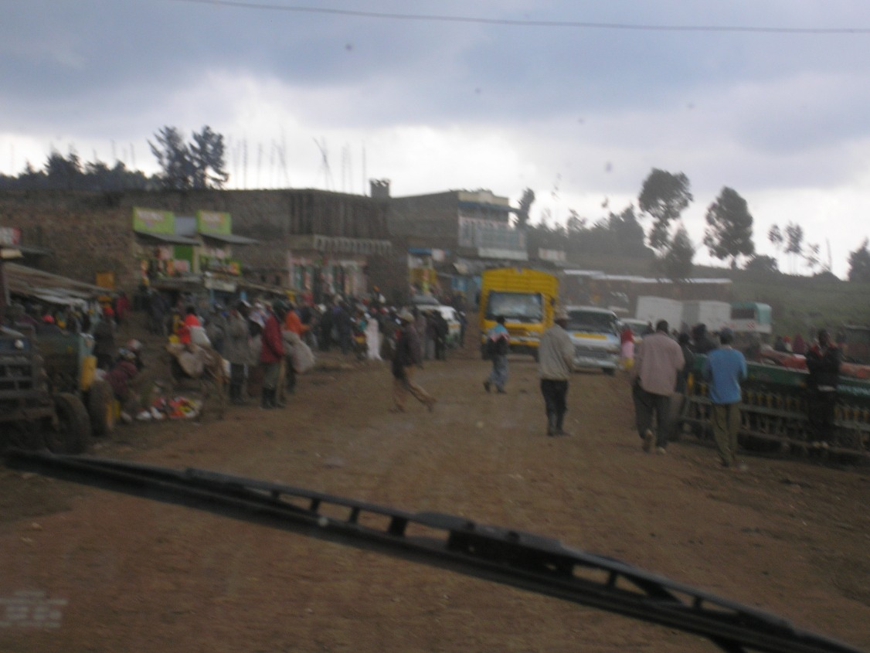
Typical downtown in Kenya. This is the city of Nakuru, the 3rd or 4th largest city in Kenya.

Slide 19
Typical roadside truck stop.
You can get a prostitute here for as little as US $2, and the truck drivers often do. AIDS is rampant, some estimates say as high as 50% in these truck stops. Then the truck drivers take the disease home to their families. Education about HIV/AIDS is still not great. Condoms are not something that most Kenyan men would choose to use.

Slide 20
Handicraft market in Nairobi.
Mostly women make baskets, beaded jewelry, trinkets out of wood/pop cans/whatever they can find and bring them to the city to hawk to tourists. They lay their goods out on tarps or blankets in a muddy lot and sell hours worth of work for a few cents. We bought gorgeous baskets that would sell for $20-40 dollars here for $3 a piece...and we didn't barter at all.

Slide 21
Morocco
Streets of Morocco. Most of these pictures were taken in Casablanca and Marrakech. People still work by hand. Animals are generally not treated as well as we would expect here. The people live hard lives, and the animals are forced to work, because if they don't the people will suffer more.

Slide 22
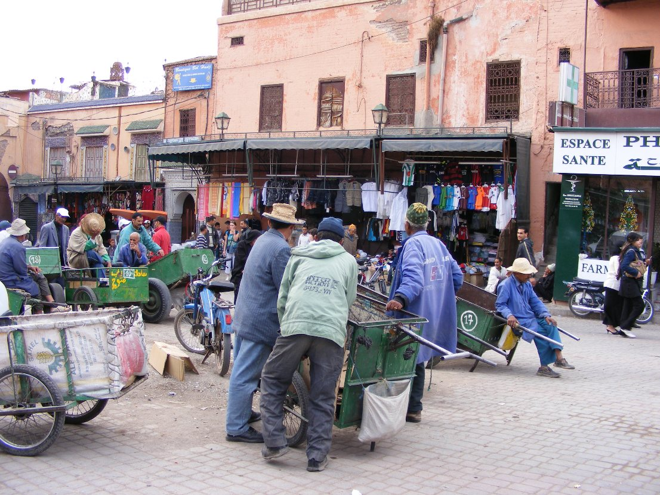

Slide 23
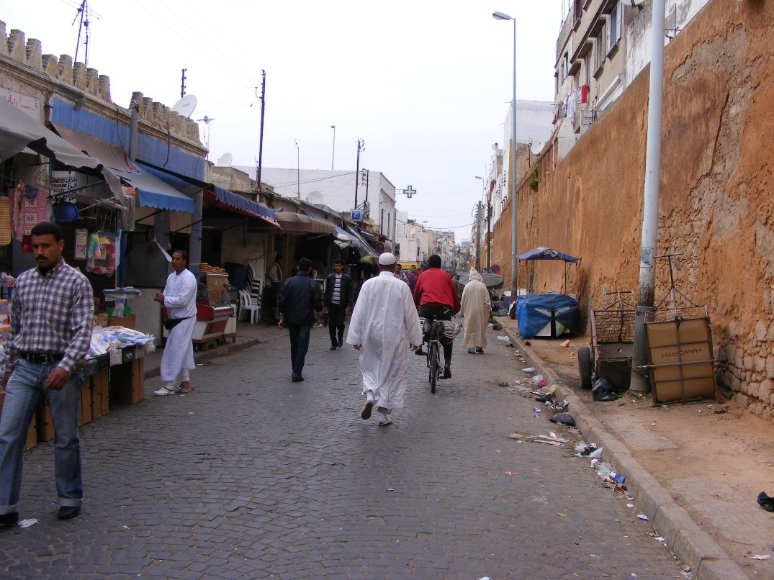

Slide 24
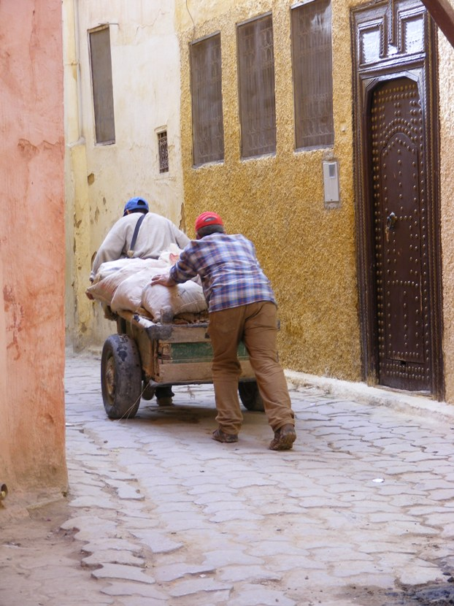

Slide 25
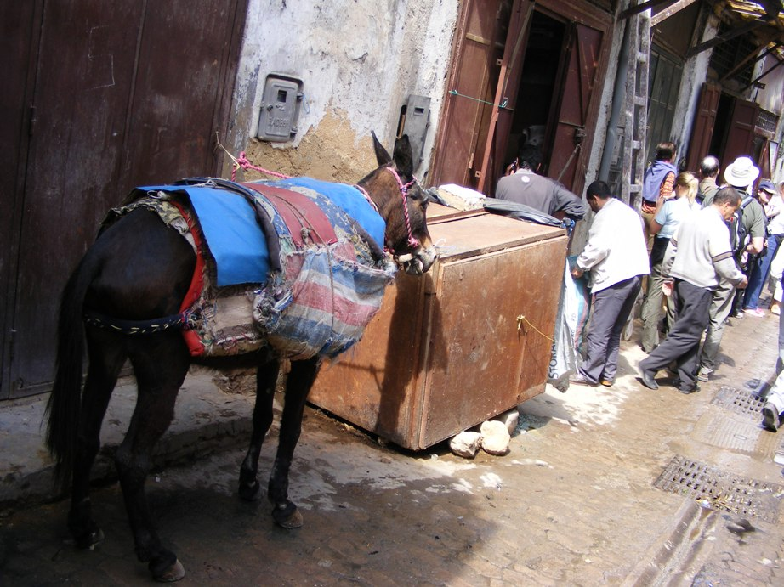

Slide 26
Hazards of the job in Morocco
This is a tannery, where hides are tanned to make leather. The chemicals used to tan the leather are often toxic, and many of the workers here end up getting sick from exposure to them.

Slide 27
Tile/stone mosaics are very popular in Morocco. These men sit on the floor all day and hammer rocks into geometric shapes to fit into mosaics. The dust from the rocks often damages their lungs.

Slide 28
The Other side of Poverty
And yet...there is beauty and happiness in these countries...sometimes more than we see at home.

Slide 29
Cambodia
villagers in Kampung Phhloc. Families stick together, and generally look after the young and elderly. Children often tend to be raised by the village, not just one mother.

Slide 30
Buddhist Statue
Cambodia combines Buddhism and Animism (traditional belief in multiple deities). People tend to hold to their religion and traditional ways much more than we do here. Could we say that Cambodians have "more culture" than Canadians?

Slide 31
Children play and fish in the ocean at Sihanoukville at sunset.

Slide 32
Ecuador
Soccer is a national pastime in Ecuador. 3 young boys in Sani Village, a small village that can only be reached by boat up the Rio Napo from the city of Coca.

Slide 33
people from Otavalo, take immense pride in dressing in their traditional clothing. Women and men wear their hair long and in braids. The women wear beautiful dresses and their traditional hats, and men wear slacks and the same traditional hats. These women were at an early morning animal market, where all the local villagers bring their livestock on Saturday mornings for sale and trade.

Slide 34
Market Day
The markets are full of fresh-cooked delicacies and amazing backyard-grown produce. Everyone meets to share what they have with others.

Slide 35
Kenya
Maasai villager. The men take the cattle out for grazing and water each day, and the women tend to the village chores and the children. Children are raised by the village, and once they are old enough to be weaned, they may not necessarily even sleep in their mother's house, but may stay with a neighbour if there is room. The Kenyan government is trying to assimilate the Maasai into cities in the same way that First Nations were assimilated in Canada, but the Maasai are proud of their traditional lifestyle and have resisted the government.

Slide 36
Traffic jam on a Kenyan highway
Not everyone on the road has a car in the traffic jam...but everyone comes to help out. It is very common, in Kenya, if you have a problem like this, for a huge group of people to turn up to discuss the options and help you out. It is expected, that if someone asks for help, you will give it if you are able. It is not uncommon for a passer-by to ask for a drink of your water, if they see you have some, and it would be considered outlandish not to share if you had some to spare.

Slide 37
Morroco
Muslim women sit outside the walls of an old city, chatting. Morocco is not an "extreme" muslim country, and in the bigger cities, you will see girls who dress very western (although you will never see "uncovered" bodies). These are older women, who still dress in a more traditional way, and often still sport facial tattoos, which identifies the tribe they are from.

Slide 38
Children get together on an empty patch of land to have a game of barefoot soccer. No matter that they do not have the proper shoes or equipment. They play with whatever they have.

Slide 39
Wool nomad tents at the edge of the Sahara desert. Seems a harsh life, but the tribespeople are very welcoming. They keep cats and dogs, to keep vermin out, and their goats run over the tops of the wool tents. Sometimes there will be an old dirtbike, for making trips out of the desert.

