Slide 1
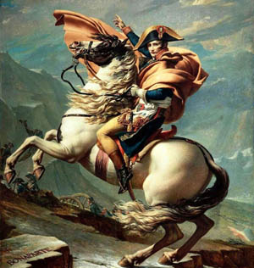
Nationalism
A Spark from that nearly destroys the 20th Century

Slide 2
Nationalism
Excessive feeling of patriotism towards one’s country
In its most extreme form, can justify racism
“Patriotism is when the
love of your own people comes
first; nationalism is when hate
for people other than your
own comes first”
–Charles De Gaulle

Slide 3
Inspired by the French Revolution
Europeans loved how France threw out a tyrant and remade their country.
Loved the ideas of the revolution, particularly “Liberty, Equality and Fraternity”
Many countries (such as Italy, Austria) greeted Napoleon as a hero hoping that he would bring “Liberte, Egalite and fraternite” to their countries.

Slide 4
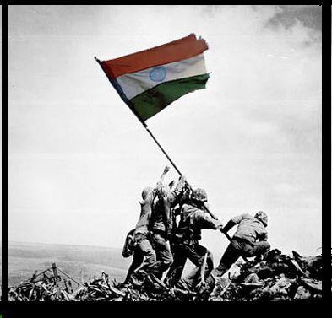
Napoleon used Nationalism
He promised many people that spoke the same language and had the same culture that he would help them establish “nations” in exchange for their support.
Used this promise to conquer Europe
New concept, before people identified with their religion or social class.
Napoleon always put France first, established his relatives as kings of these countries

Slide 5
Spain
Concept worked against Napoleon in Spain
1808 invaded Spain to force them and Portugal to be part of the Continental system
Napoleon replaced their king with his brother Joseph
Spain hated that, they
helped Napoleon attack
Portugal, but then they
turned against Napoleon
Used guerilla warfare tactics

Slide 6
Guerilla Warfare
Invented in Spain
Means “Little War”
Strategies: ambush, hide in civilian clothing, hide in villages
Difficult to fight with traditional army tactics, don’t know if you are killing a soldier or an innocent person, soldiers get frustrated and paranoid, causes them to act in atrocious ways
Used in Vietnam, Afghanistan, Israel, etc.

Slide 7
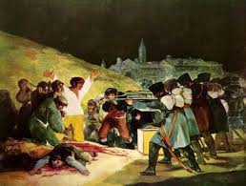
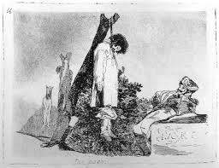
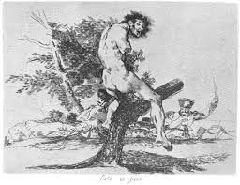
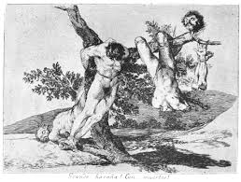
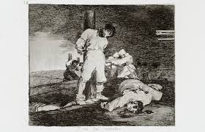
GOYA’S DISASTERS OF WAR
-not published during his life
-protest to Napoleon’s occupation of Spain
-starts off with France’s atrocities, but then develops into the Spanish guerrilla's atrocities as well

Slide 8
First Big Mistake Napoleon Makes
War with Spain devastates Napoleon’s Army
Forced to leave many troops there to maintain peace.
Ashamed by situation in Spain and mad at Tsar Alexander for breaking their treaty by ignoring the continental system, Napoleon turns to Russia to try to get total control of Europe…

Slide 9
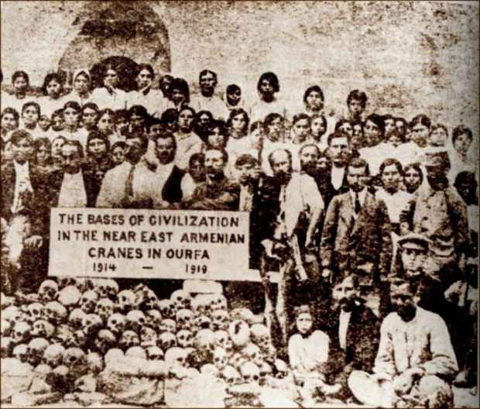
Nationalism in the 20th Century: World War One and The Armenians
War broke out in August 1914 mostly due to Germany, Britain, France and Russia desire for more colonies and power for their countries
Armenian genocide
1915: Ottoman Empire
(present day Turkey)
rounded up and
assassinated 1.5 million
Armenians (ethnic group in
Turkey)

Slide 10
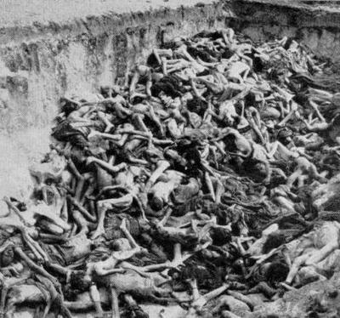
World War Two and The Jews “Who now remembers the Armenians?”- Adolf Hitler
World War Two began because Hitler wanted to create a “Third Reich” (German Empire) in Europe
Extremely racist against non-Germans
Rounded up 6 million Jews and killed them through starvation, disease, firing squads and gas chambers
Also killed Slavs, Poles, Communists, Jehovah’s Witnesses, Catholics, Africans, homosexuals and mentally deficient people

Slide 11
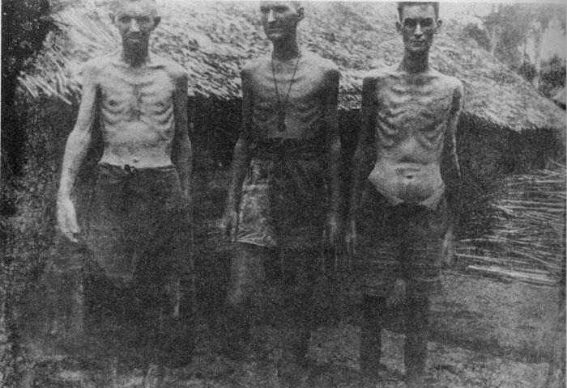
Japan
Invaded China in 1938
Wanted a Japanese Empire
Killed 10 million Chinese,
Indonesians, Filipinos and Koreans
Japanese instructed by their emperor Hirohito to “Kill all, burn all, loot all”
Special Japanese military units conducted experiments on civilians and POW
Victims subject to vivisection, amputation and experiments with biological warfare
Anesthesia was not used

Slide 12
Yugoslavia
Country created after world war two
Made up of many different ethnic groups (now it is Kosovo, Macedonia, Montenegro, Croatia, Slovenia, Serbia and Bosnia)
In 1990s a man name Slobodan Milosevic took over
Saw Serbians as the most important ethnic groups in Yugoslavia, wanted it just for Serbs
Killed and tortured 30 000 non Serbs

Slide 13
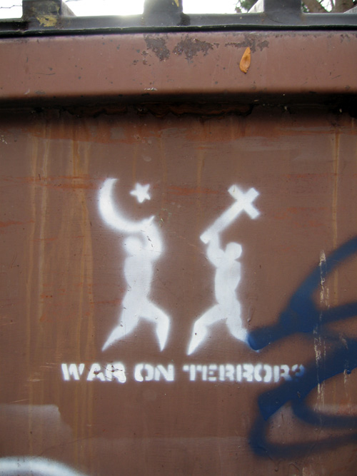
American War on Terror
Inspired by the September 11 attack
Attack on Islamic fundamentalism
Invaded Afghanistan to find Osama Bin Laden
Invaded Iraq to overthrow dictator Saddam Hussein
Stated objectives: to protect US citizens and allies
Criticized as an excuse to break human rights laws and fight pre-emptive wars

