Slide 1
The Canadian Identity
One, Two or Many Nations???

Slide 2
Multiculturalism
1918-1960 Restrictive Immigrations Policy
-1930→Closed (Remember none is too many?)
-Preference given to Europeans (particularly North)
1960s Open Immigration
1962 Remove restrictions on Asians and Africans
1967 Colour Blind, use point system
1971 Official policy of multiculturalism. Immigrants have enhanced and enriched Canadian culture (plus they have good food!)
1976 allow immigration of family members if relatives already here
1960s → now: Allow refugees

Slide 3
Thoughts on Multiculturalism
“Multiculturalism is the key to Canadian Unity” Hedy Fry Immigrant
“Anyone critical of multicultural policy is immediately branded a racist, a sellout or a traitor” Neil Bissoondath
Immigrants come here to become Canadians; to be productive and contributing members of their chose society […] I did not come here to be labeled as an ethnic or […] to be coddled with preferential treatment” Rais Khan, Professor
“It is precisely the policy of multiculturalism that has brought ethnic minorities out of the so-called ghettos” Myrna Kostash

Slide 4
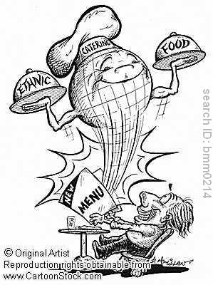
Problems???
Christmas Carols and holidays in schools
Created disunity or unity?
-ethnic enclaves (China
Town, Little Italy, good? Bad?)
What do you think?

Slide 5
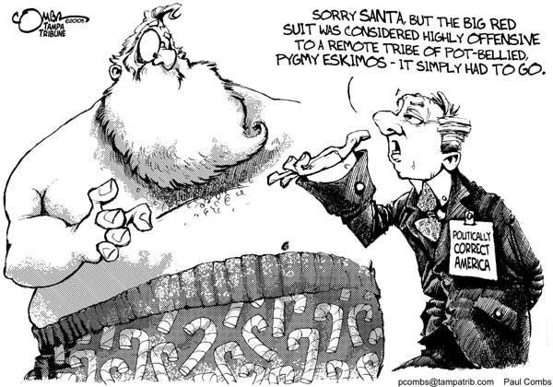

Slide 6
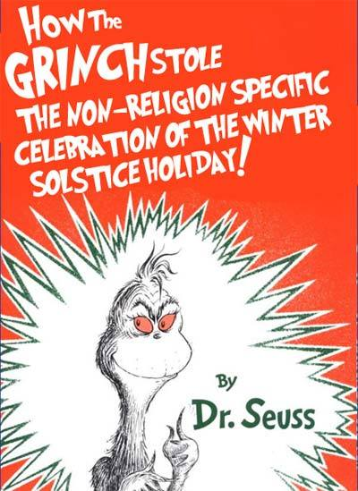
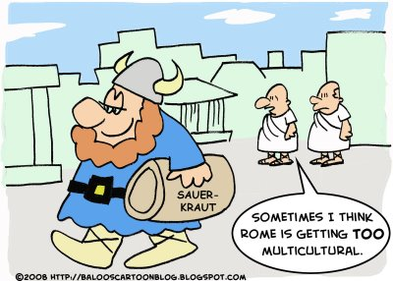

Slide 7
Aboriginals 1960s to Present
Treated Poorly in our history
Residential School –taken away and abused
Even after schools closed, conditions on reserves terrible: poverty, poor health, inadequate housing and education
1968 National Indian Brotherhood formed to lobby gov’t
White Paper 1969 Aboriginals should be treated like anyone else, no special treatment→ assimilate to end problems
Red Paper → Demand control over own affairs

Slide 9
Things start to get a little better
1960 given the right to vote
1960s open band schools, few high schools so have to board with families in city to go to highschool, many lonely and drop out
1970s Berger Commission → Hear concerns over mega projects on their land
1980s given right to self government on reserves

Slide 10
And then come to a head: The Oka Confrontation
Where: Quebec (Town of Oka)
When: July –September 1990
Who: Mohawks vs. Police + Oka Town
What: Oka wants to build a golf course on sacred land. Mohawks block construction. Police come. 1 is shot. Army called in. Federal government buys land and gives to Mohawks
Significance: Aboriginals are prepared to fight for their rights!

Slide 11
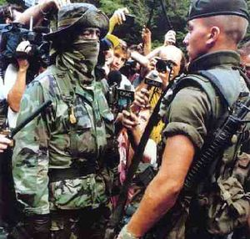
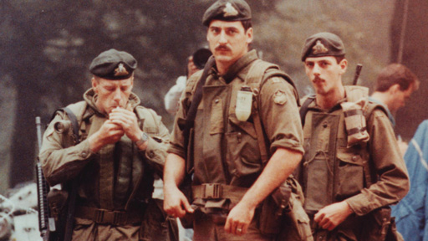
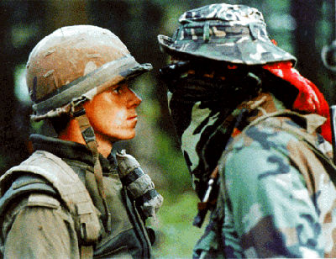
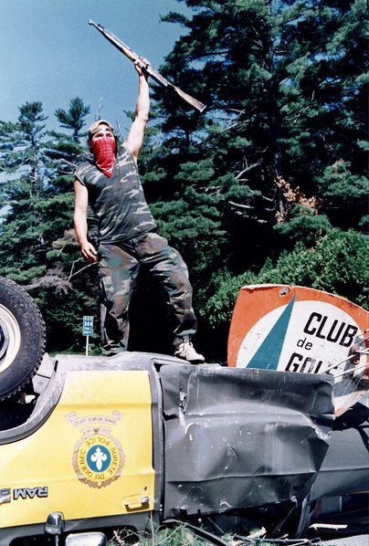

Slide 12
Once again, relations begin to improve: Land Claims
1993 Nisga in BC
Delagamuluklew Case (they owned the land before 1763 Proclamation)
-If you can prove that you get title
1996 get land → Create own municipal gov’t
Federal government give 190 million over 15 years
Own police
No longer tax exempt

Slide 13
Land Claims in Canada

Slide 14
Nunavut
1.6 million KM = largest treaty ever negotiated in Canadian history
New territory
Inuit in political control
Traditional consensus government

Slide 15
Nunavut
Iqaluit
Nunavut Legislature

