Slide 1
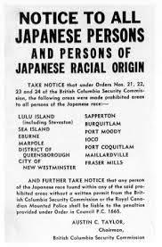
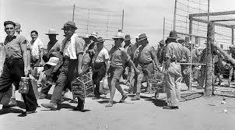
Japanese Internment

Slide 2
What it was?

Slide 3
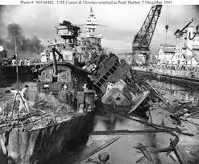
After the pearl harbour bombing and the invasion of Hong Kong the Canadian government, under the War Measures Act, moved all people with a Japanese background within 62 km of the coast of British Columbia to internment camps.
The government called this evacuation a security precaution
They thought that if the Japanese attacked British Columbia’s coast they’d feel loyal to Japan and turn on the Canadians living there.

Slide 4
Where this happened?

Slide 5
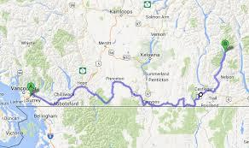
This took place on the coast of British Columbia; it happened within a 62 km of the coast.

Slide 6
Who was involved?

Slide 7
Canadians sent all people with a japanese background to internment camps; including Japanese who already had a Canadian citizenship.

Slide 8
When did this happen?

Slide 9
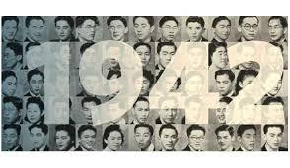
February, 1942-1947

Slide 10
Why was it significance to Canada?

Slide 11
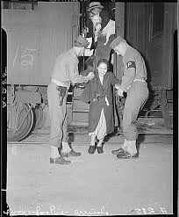
This showed racism from Canada towards people with a Japanese background.
In the end when Japan did not attack Canada they let all the people sent to camps out.
The Canadian government also gave payments of $21,000 to them to apologize to everyone who was still living and as well as other money to the Japanese-Canadian community as a whole.
They were also given their Canadian citizenship back.

Slide 12
Other interesting/ important facts

Slide 13
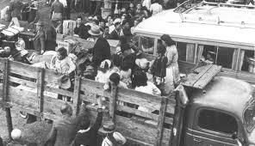
In december of 1941, Canadian soldiers were held in Japanese Detention camps so the Canadian government was too afraid to hurt any Japanese people in the internment camps in fear that their soldiers would be hurt in Japan.
Known as one of the worst human rights violations.
Federal Government Officials, called Custodians of Enemy Property were given the power to confiscate and sell Japanese Canadian’s possessions

