Slide 1
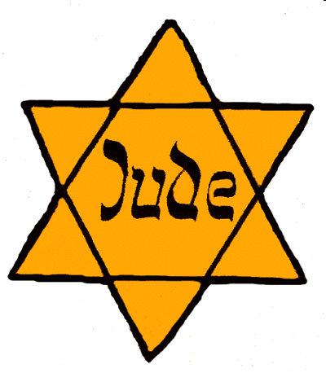
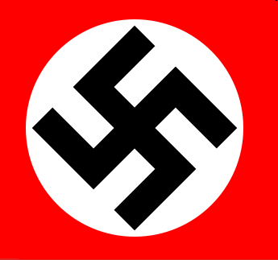
A Brief Introduction to the Holocaust

Slide 2
Is there such thing as an innocent bystander?
“First they came for the Communists, but I was not a Communist so I did not speak out. Then they came for the Socialists and the Trade Unionists, but I was neither, so I did not speak out. Then they came for the Jews, but I was not a Jew so I did not speak out. And when they came for me, there was no one left to speak out for me.” —Martin Neomoeller
“All that is required for evil to prevail is for
good men to do nothing.” --Edmund Burke

Slide 3
The Beginning
Germany was devastated by World War One and forced to pay for the war by Britain, France and Russia despite the fact that many people were starving
The population was very unhappy and looking for someone to blame, they chose a traditional scapegoat: the Jews
In 1933 a man named Adolf Hitler and his Nazi party were elected to parliament, he promised that the Jews would pay for all the harm being caused to Germany
Propaganda was used to ensure all Germans would hate Jews

Slide 4
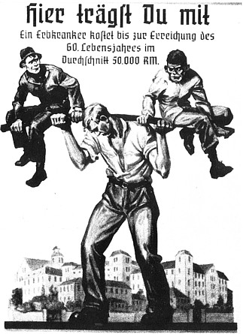
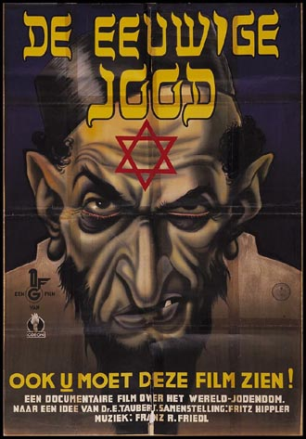
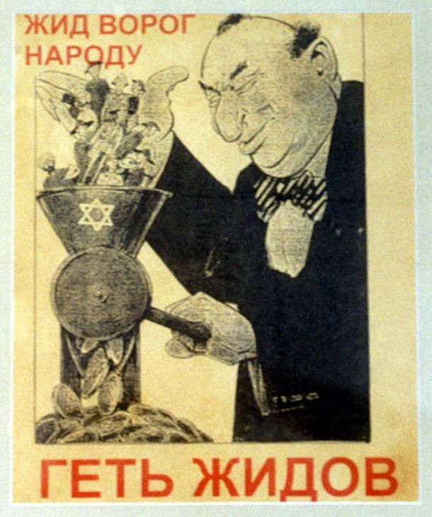

Slide 5
The Progression
1934 Boycotts Jewish businesses
1935 Nuremberg Laws strip Jews of all rights (to go to school, marry, go to the hospital, receive aid etc.) Jew= at least one Jewish grandparent
November 9 and 10, 1938, Kristallnacht (night of the broken glass). Jewish business and synagogues destroyed, Jews beat up and arrested all over Germany and Austria. Many sent to Concentration Camps

Slide 6
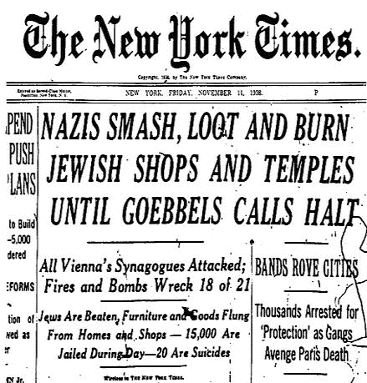
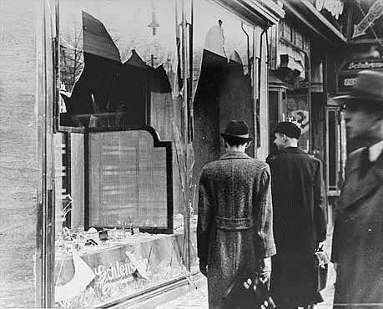
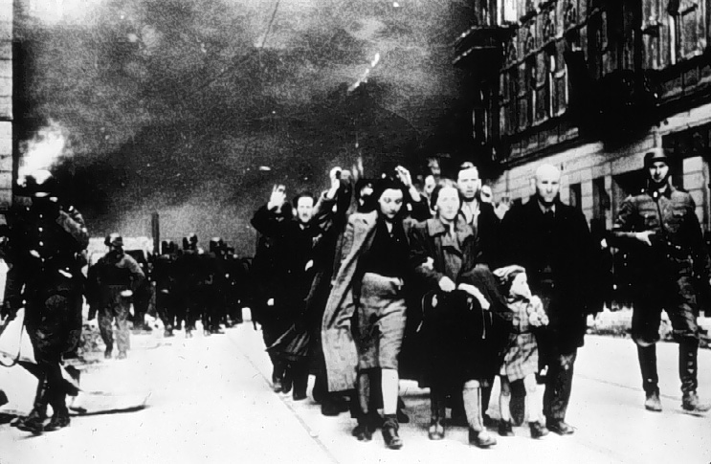
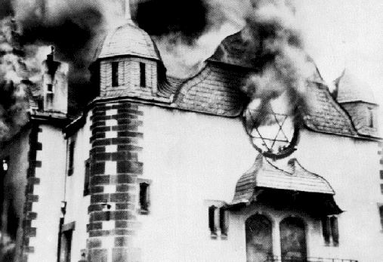

Slide 7
The Progression Continued
1939 World War Two Begins, Jews deported by train from all areas under German control (Poland, Austria, Germany, Czechoslovakia) to newly set up ghettos in Poland. Conditions are horrendous, no food, full of disease, cramped and dirty
As Germany conquers more and more territory (France, Belgium, Russia, Hungary, etc) more Jews deported, ghettos bursting at seam. Nazis decide something else must be done.

Slide 8
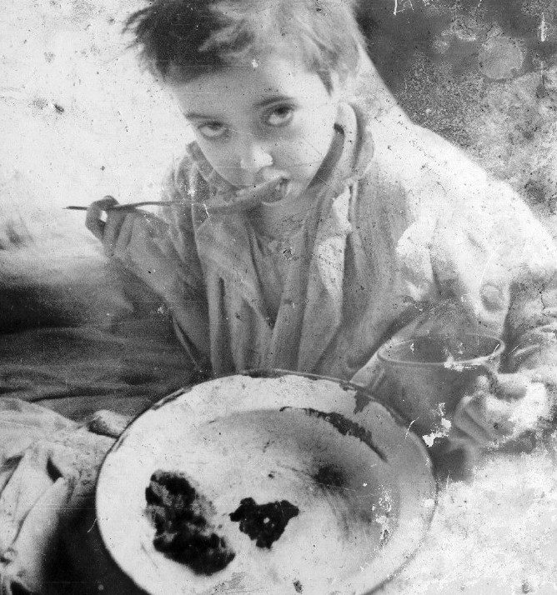
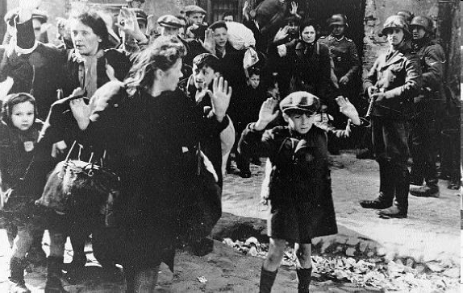
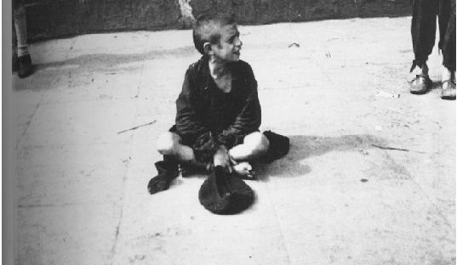
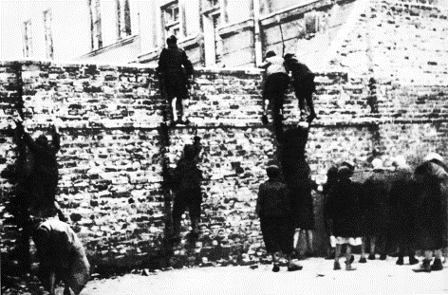

Slide 9
The Holocaust
1942-1945
Systematic (intentional and planned) destruction of Europe’s Jews
Sent by train from ghettoes to death camps or work camps (and then to death camps)
How? Mass killings by Einsatzgruppen (firing squads in Russia) and Gas chambers with Zyklon B Gas, evidence burned in crematorium ovens. Largest camps was Auschwitz.
6 million killed in total (camps, ghettoes, Einsatzgruppen)

Slide 10
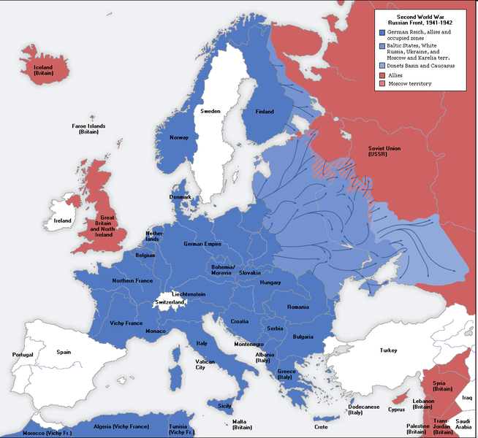
Areas under German Control
France, Denmark, Holland, Italy, Czech Republic, Luxembourg, Channel Islands, Belgium, Poland, USSR, Slovakia, Romania, Hungary, Austria, Lithuania, Norway etc.

Slide 11
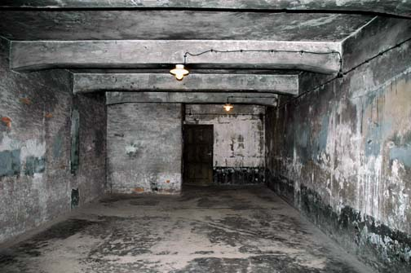
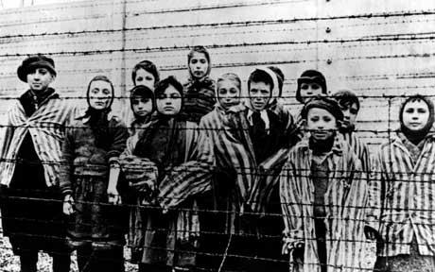
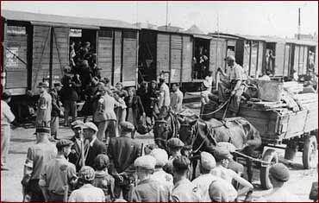
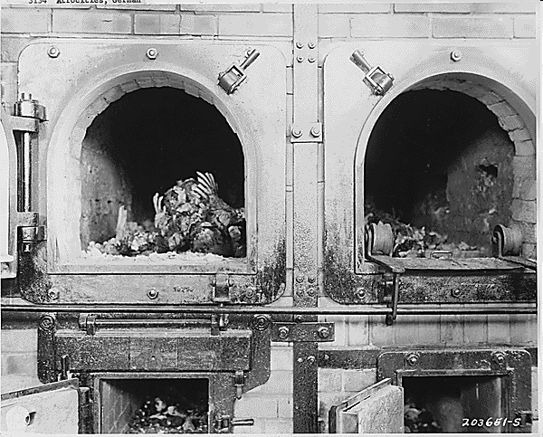

Slide 12
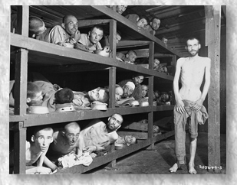

Slide 13
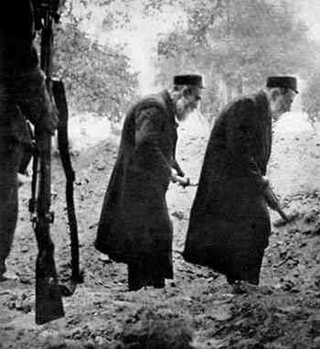
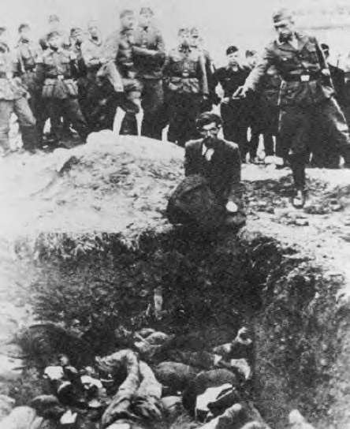

Slide 14
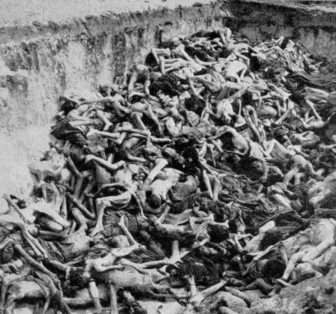

Slide 15
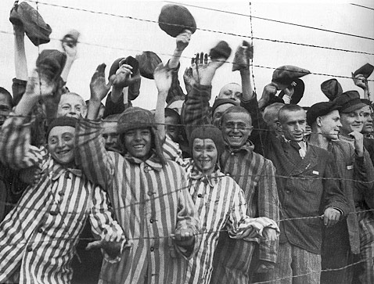
The End
War over in 1945
Russians liberated camps
Nazis put on trial for crimes against humanity at the Nuremberg Trials

