Slide 1
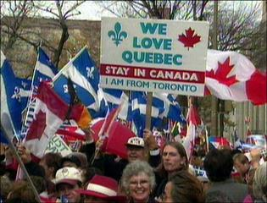
French English Relations
A Brief History of 200 + years of Quebec whining

Slide 2
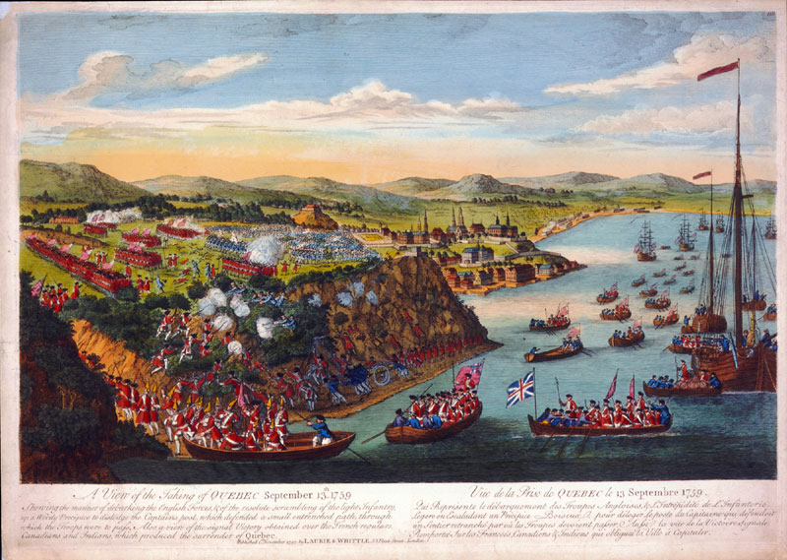
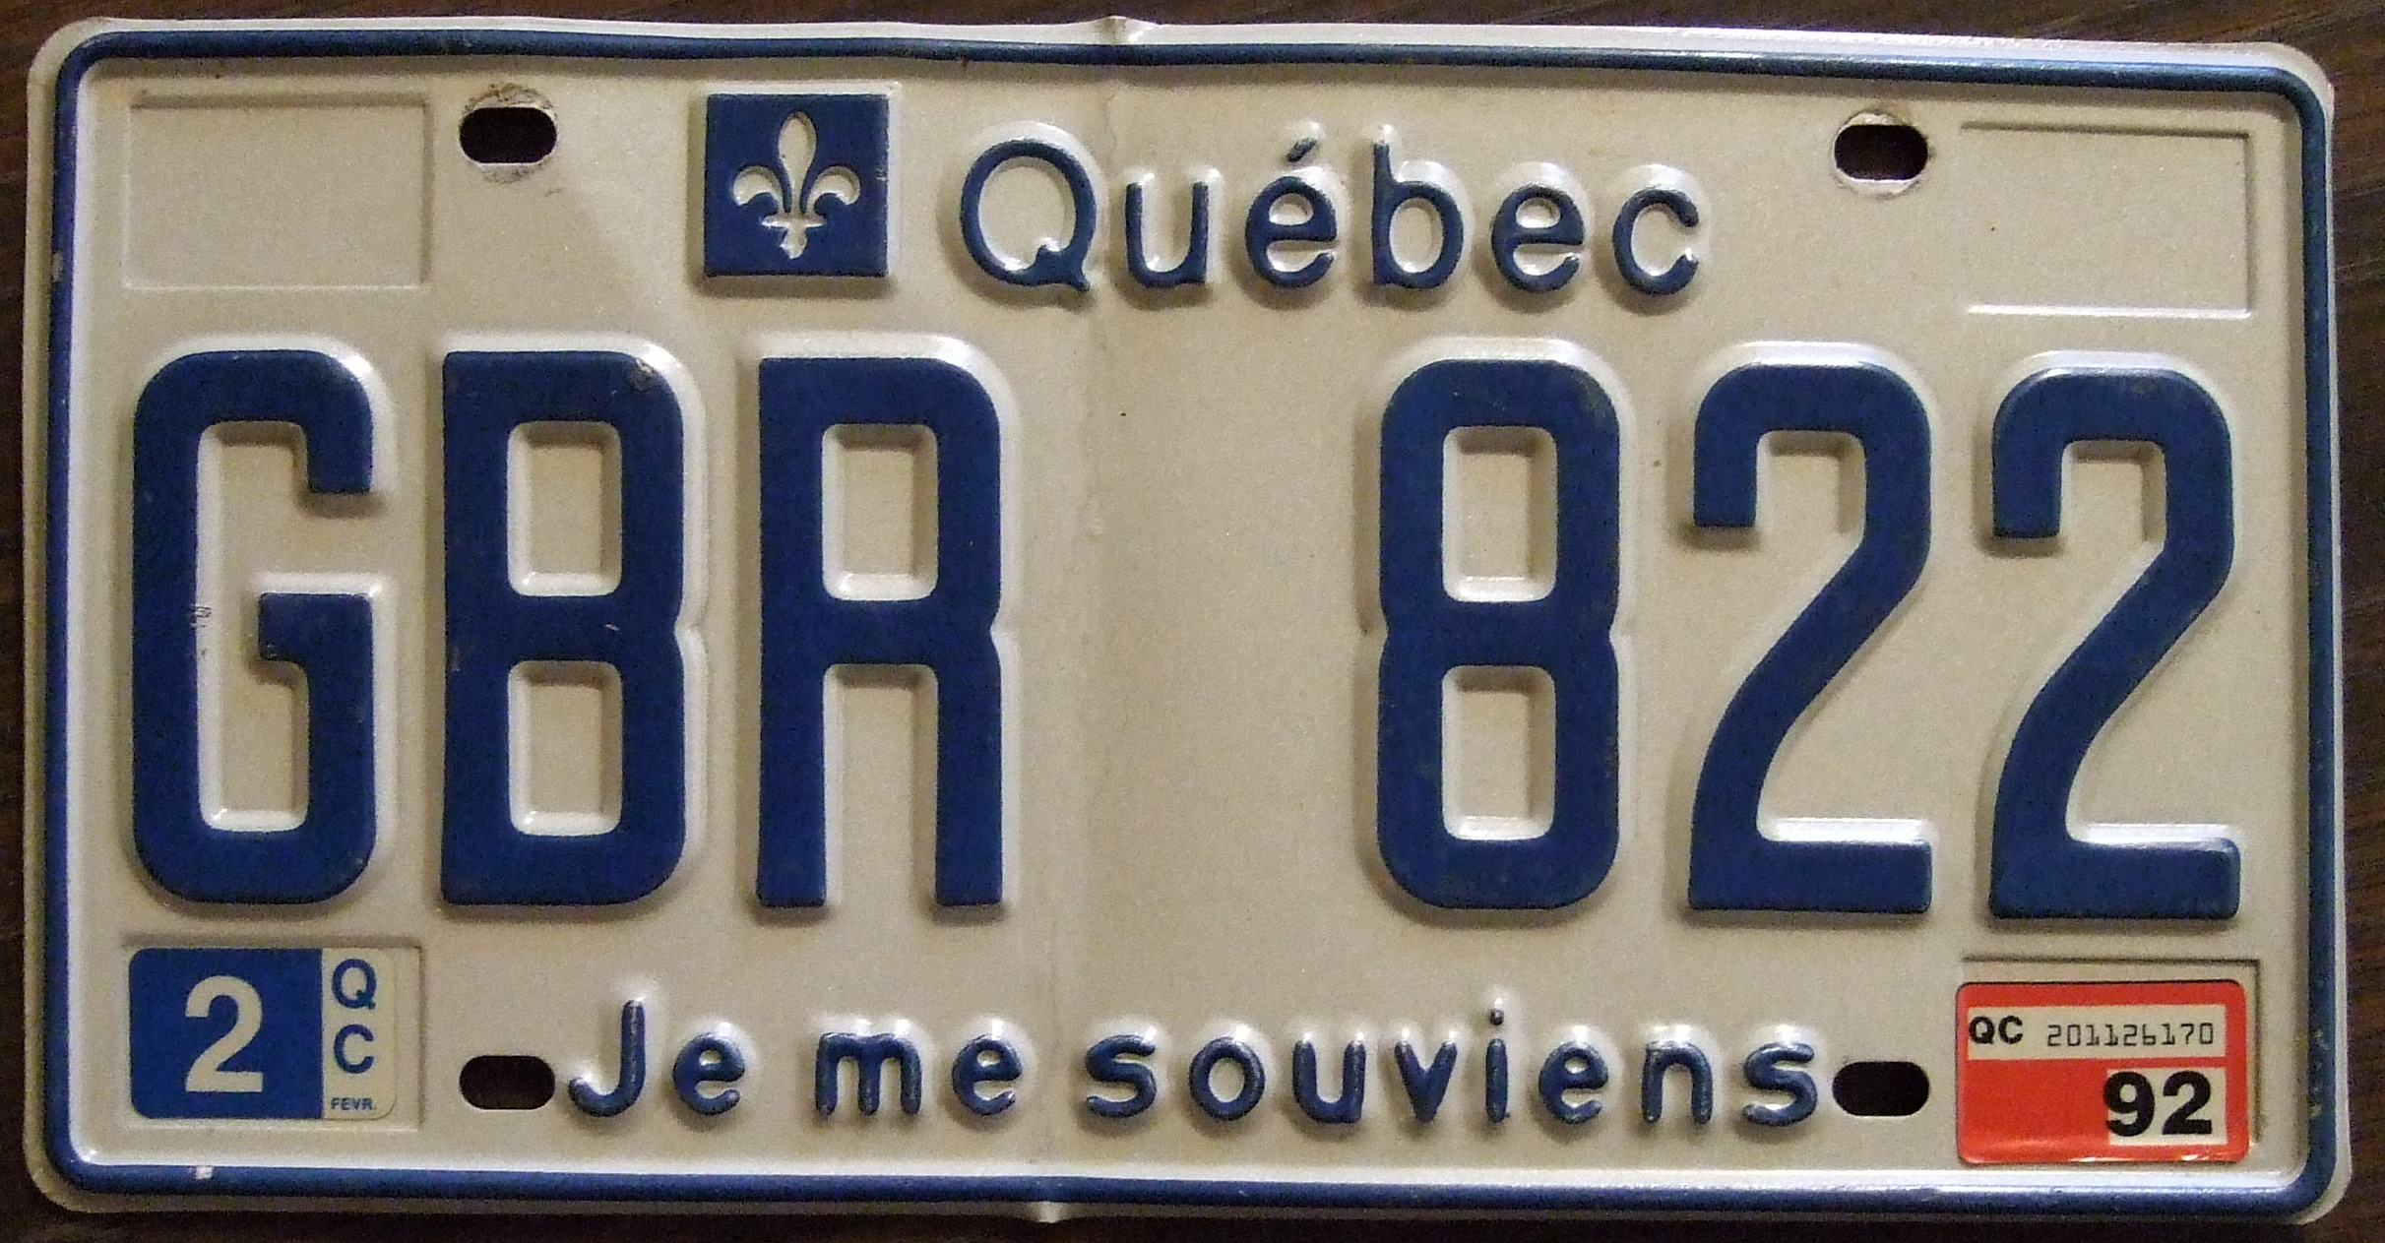
The Plains of Abraham
1763 British defeat the French in the 7 Years War
Quebec is given to the British as a prize
Not pleased, but given language and culture rights
Je me souviens license plate slogan referring to this event

Slide 3
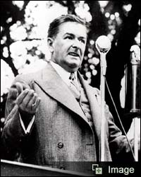
Maurice Duplessis and the Union Nationale (we can’t seemed to get rid of this guy can we?)
Premier from 1936-59
Believed Quebec was a “distinct society”
Tried to keep them Catholic and traditional
Encouraged foreign investment
in Quebec (and businesses like
this because Duplessis hated
unions)

Slide 4
Jean Lesage and The Quiet Revolution
Quebec “quietly” begins to assert its independence
Modernize education and culture (less power to church)
Maitres Chez Nous (Masters in our own house) control own affairs
Nationalize hydro, insist more French politicians in Ottawa and power in gov’t, French language dominates.

Slide 6
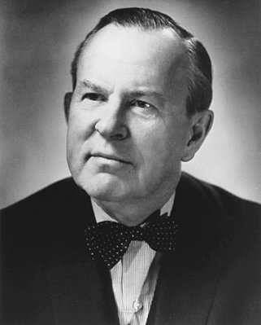
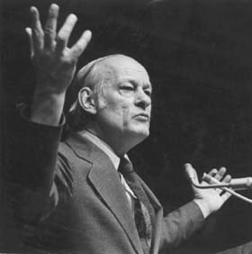
Renee Levesque and the Parti Quebecois (PQ)
Doesn’t believe Lesage did enough
Wants to separate from Canada
We want to divorce from Canada. Sorry honey, but we are too different….it’s not you –it’s me…now –don’t go crying!
Renee, baby we can work it out!

Slide 7
Ottawa Responds
1964: Canada is bilingual –now French can feel at home everywhere
1965 –you say the flag = too British, ok, new flag
More French in government jobs and in Federal government positions of power
Many Quebeckers believe this is not enough, Trudeau finally has enough and says that Quebec is not special, just another province

Slide 8
= British Choice (Our flag until 1965)
Diefenbaker and the Conservative’s Choice
Pearson’s Choice (the winner)
The Winner for Quebec

Slide 9
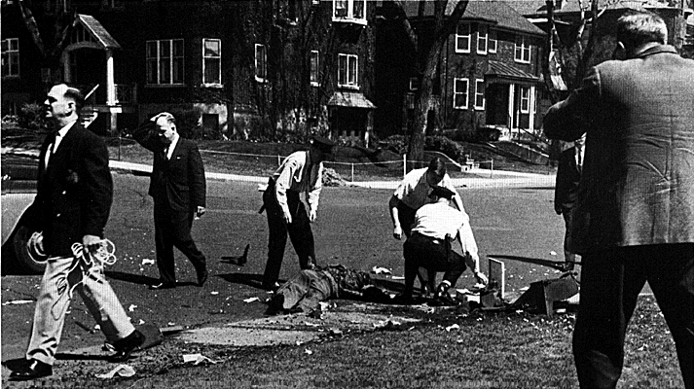
The FLQ Crisis
Front de Liberation Du Quebec formed in 1960s. Want complete independence of Quebec
Bombed symbols of English Canadian/British Monarchy power in Quebec (mailboxes, railway lines)
Oct. 5, 1970, kidnap James Cross, a British diplomat from his home
Sent Manifesto demanding 500 000 in gold, safe passage to Cuba and release of FLQ members in prison

Slide 10
FLQ continued…
Trudeau refuses to negotiate with terrorists, FLQ responds by kidnapping Quebec Labour minister Pierre Laporte
Trudeau passes War Measures Act suspending civil liberties, creating a police state and sending the army into Montreal
Reporter asks “how far will you go” Trudeau responds with “Just watch me”

Slide 11
James Cross Pierre Laporte

Slide 12
FLQ conclusion
Police found Laporte’s body (strangled) in the trunk of a car
Negotiated Cross’ release in exchange for a free passage to Cuba
450 arrested, 25 eventually convicted
http://www.youtube.com/watch?v=2qsUzNcyPjg 7 minutes to 8:30

Slide 13
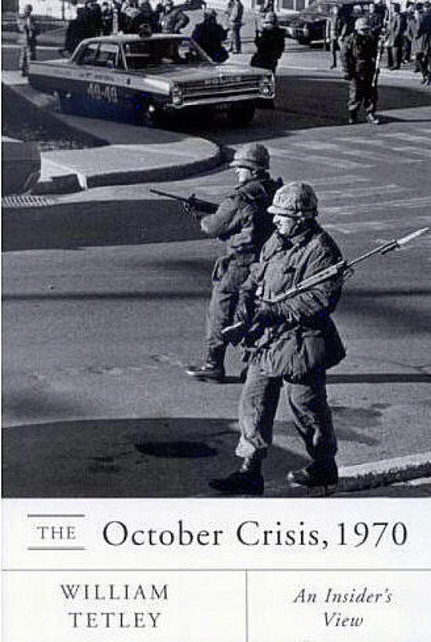
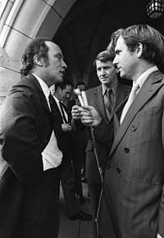
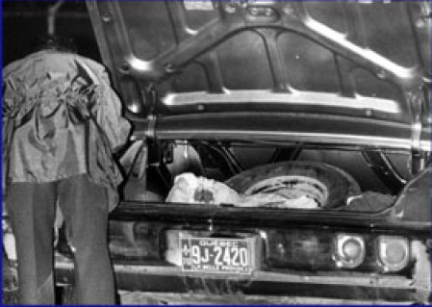
How far will you go?
Just watch me!

Slide 14
1976- PQ takes the Legislature
Bill 101
-All immigrant children must learn French
-All signs in French with English writing much smaller
1980 Referendum
-”Sovereignty Association” Quebec become politically independent, but maintain close economic ties
-Trudeau promises new constitution to recognize Quebec as distinct
-40% Yes 60% No (to separation)

Slide 15
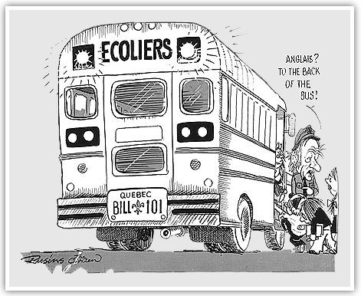

Slide 16
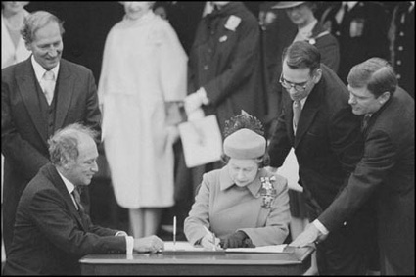
The New Constitution (law of the land)
1982 replaces BNA Act, which only British could change, Trudeau wants to “bring the constitution home
Include Charter of Rights and Freedoms
Had to agree on an amending formula, can’t agree
Decide on Notwithstanding clause (Can opt out of certain issues in constitution if you want to) during “Kitchen Compromise”
Quebec mad because not invited
Charter = law April 17, 1982

Slide 17
Meech Lake Accord
Mulroney wants to change the constitution to let Quebec be a “distinct society” and give more power to the provinces
Trudeau argues →everyone will want to be distinct
Elijah Harper Manitoba MLA; Aboriginal
-we are distinct too!
No change and Quebec is mad

Slide 18
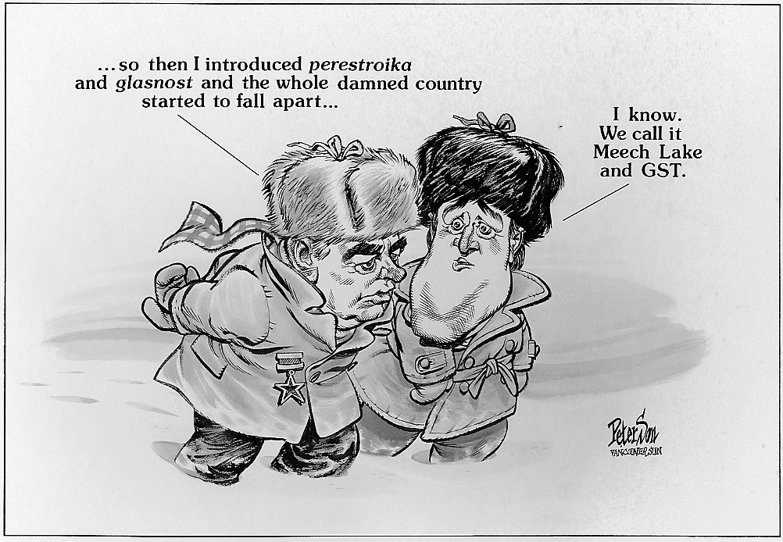

Slide 19
1995 Referendum
Bloc Quebecois (Federal party) pushes independence
New vote: 50.6 % No 49.4% Yes
Chretien → Clarity Act: We will decide what a majority is, you can’t just vote and leave
The debate continues

