Slide 1
Engaging beginnings
Pick one photo and write the beginning to a story using the photo as an inspiration

Slide 3
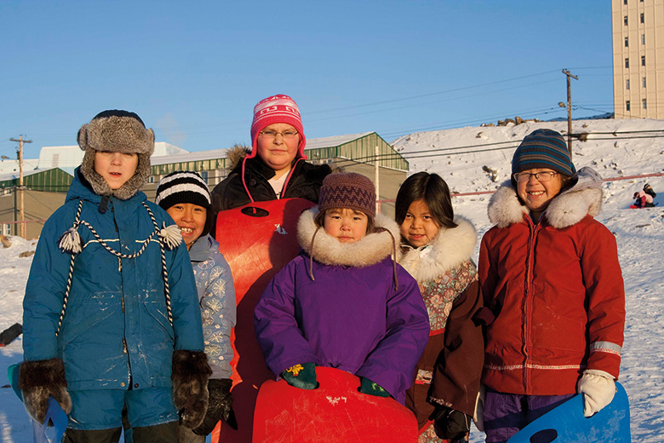

Slide 5
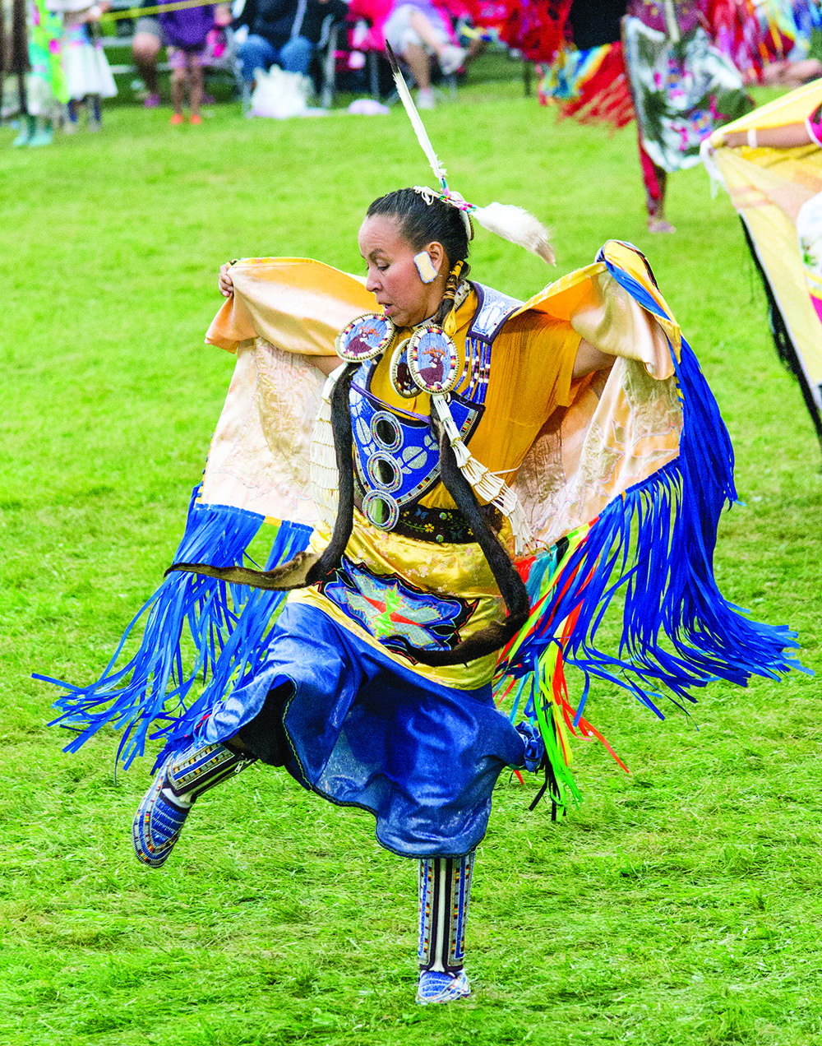

Slide 6
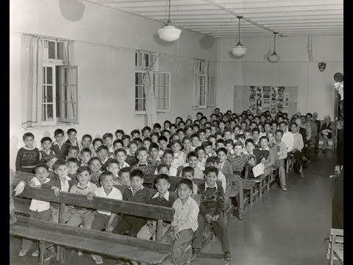

Slide 7
