Slide 1
The Diefenbunker

Slide 2
The Diefenbunker
The Diefenbunker was commissioned by Prime Minister John Diefenbaker in 1959, as part of his government’s reaction to escalating tensions in the Cold War.
The purpose of the bunker was to house key members of the government and military in the event of a nuclear attack on Canada.
The safety of its nuclear roof would allow the Canadian government to operate safely underground for 30 days in order to assist with the governance and rebuilding of the country.
When building began in 1959, it was a top-secret operation under the code name Project Emergency Army Signals Establishment (EASE).
The entire construction process took less than 18 months, it is built to withstand a 5 megaton nuclear blast from 1.8 kilometers away.
Designed to hold 535 people for 30 days
Cost 20 000 000 to build and much more to maintain!
It was fully functional until 1994

Slide 3
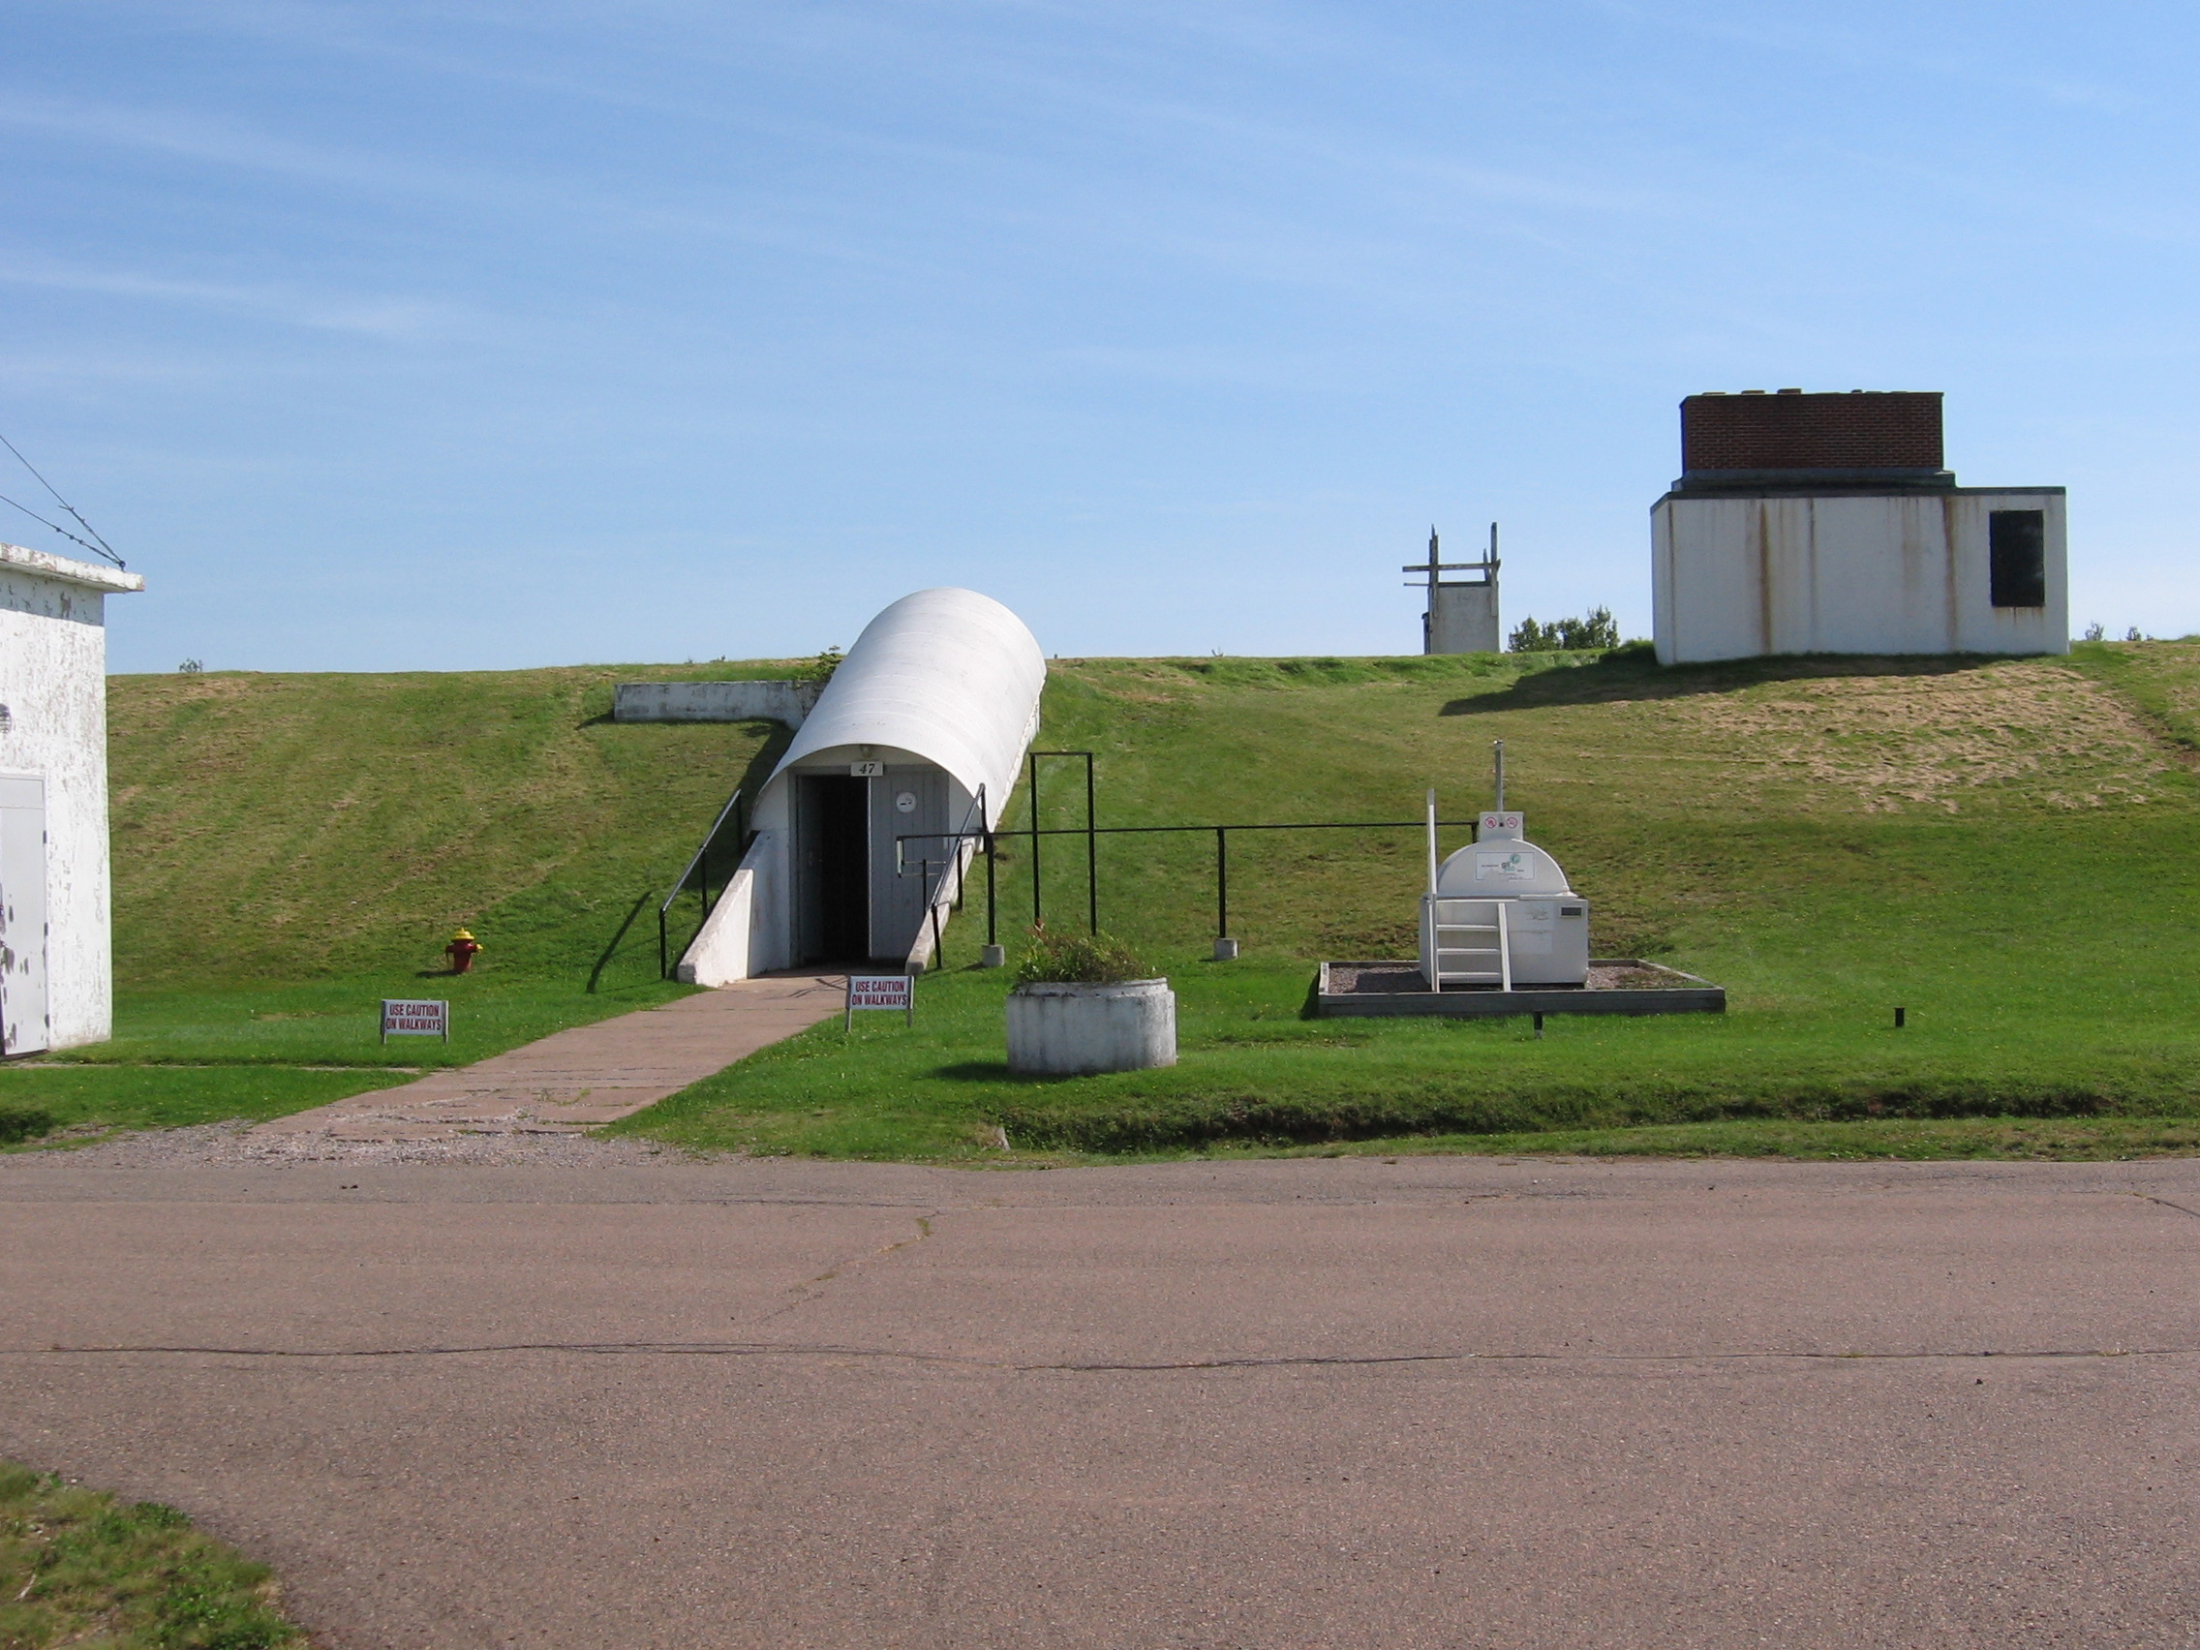

Slide 4
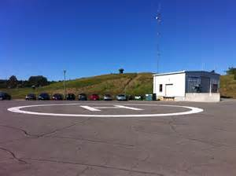

Slide 5
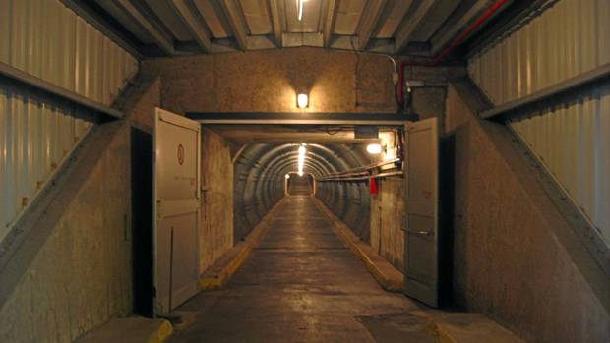

Slide 6
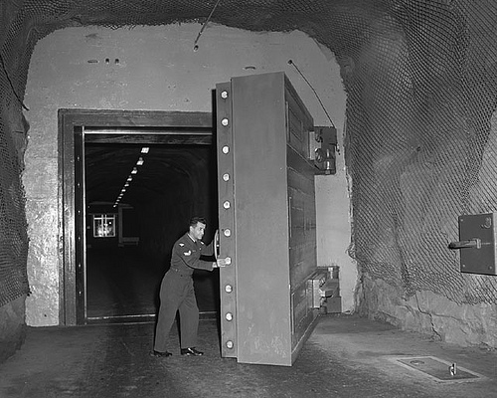
Blast Door

Slide 7
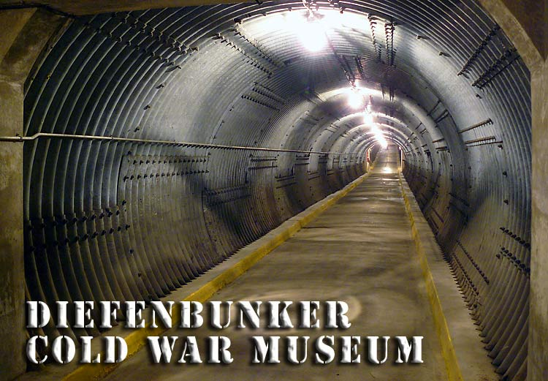

Slide 8
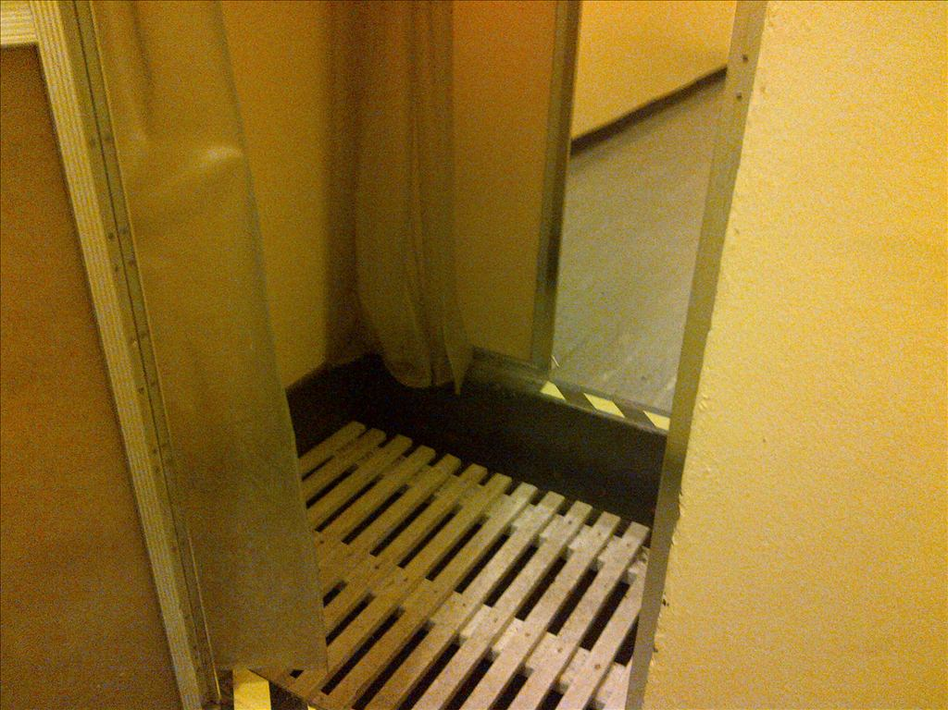
Decontamination Shower

Slide 9
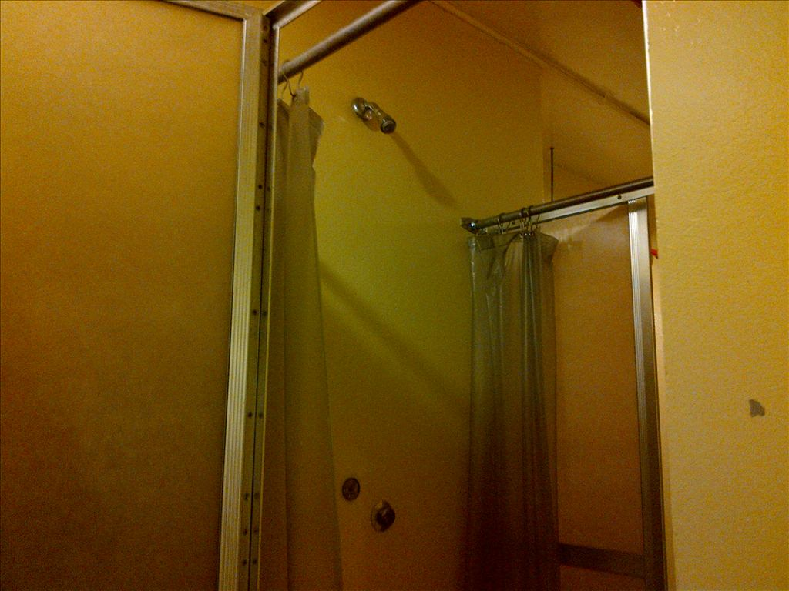
Decontamination Shower

Slide 10
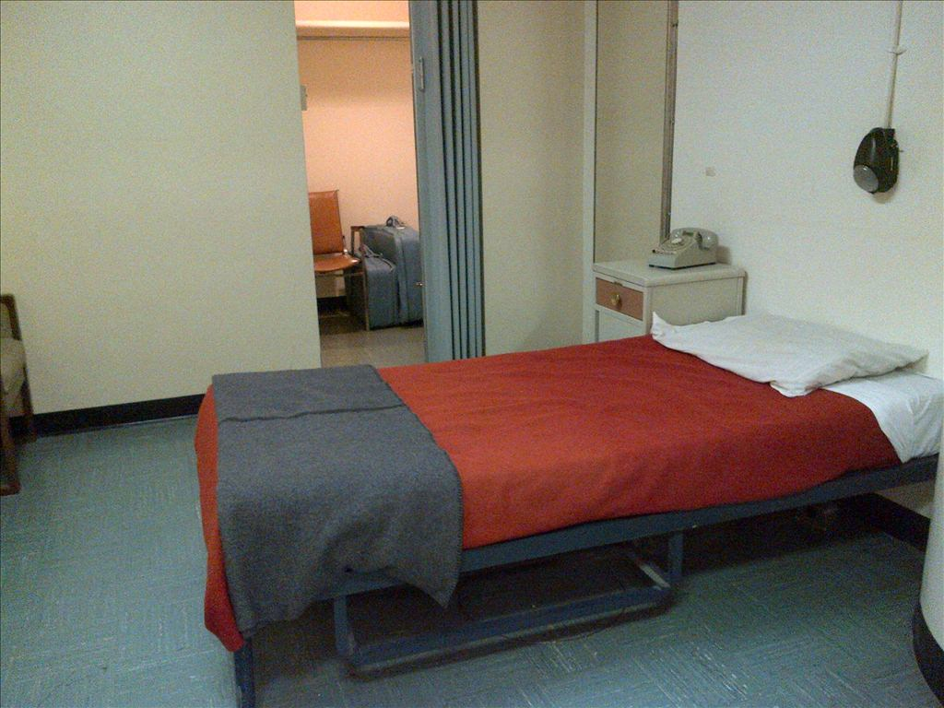
Prime Minister’s Room

Slide 11
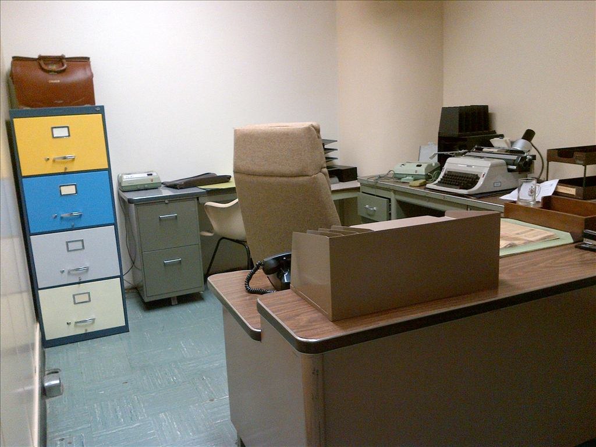
Prime Minister’s Office

Slide 12
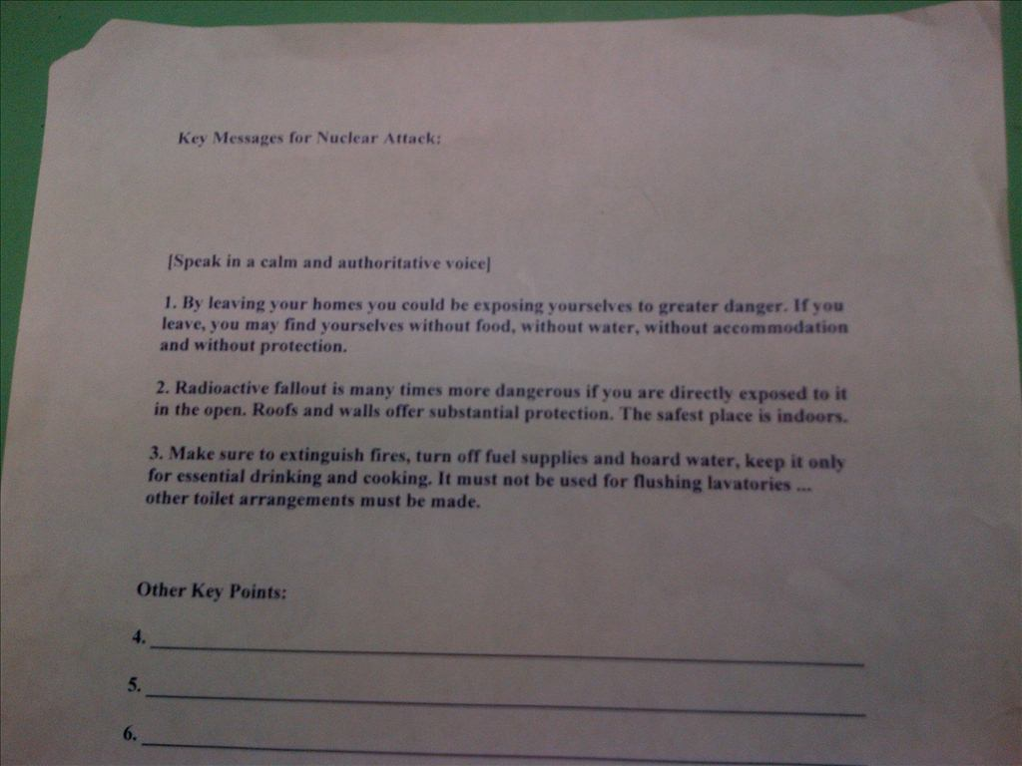
Radio Message for the PM

Slide 13
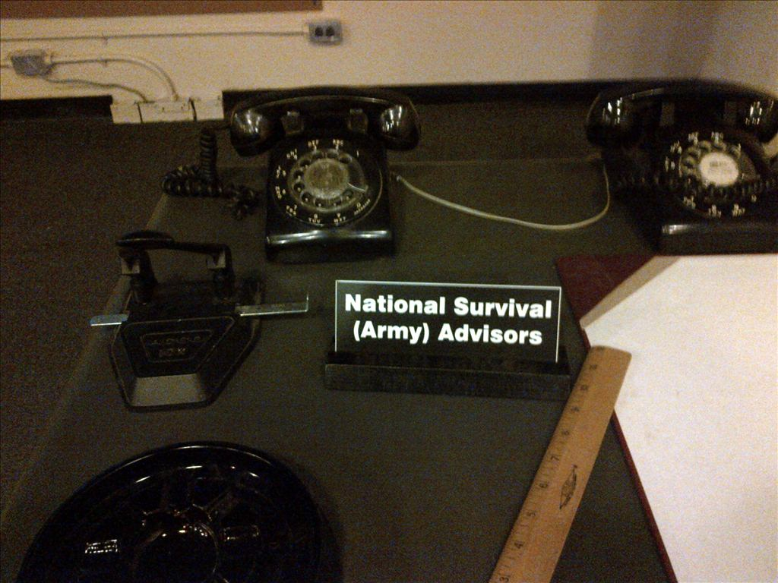
Communication Room

Slide 14
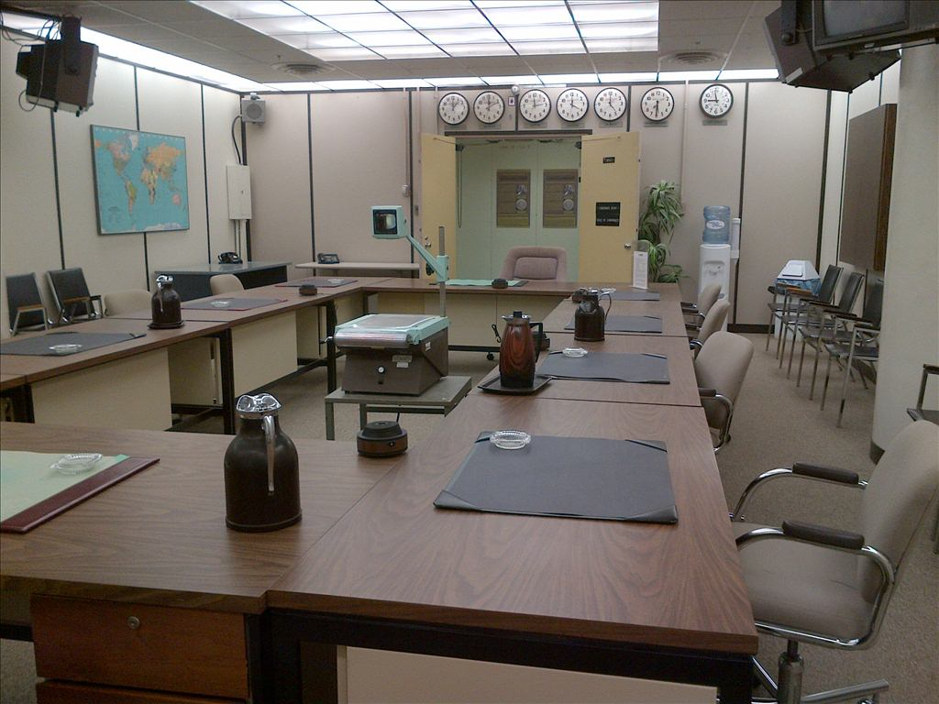
Board Room

Slide 15
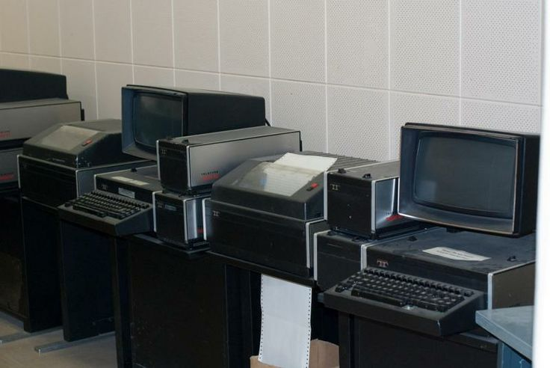

Slide 16
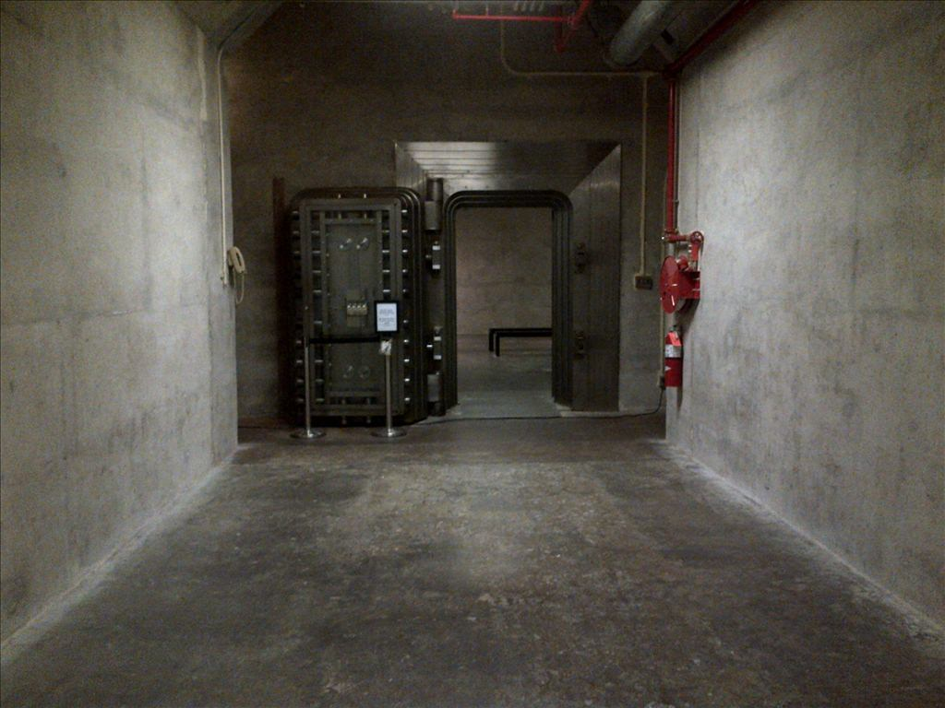
The Vault

Slide 17
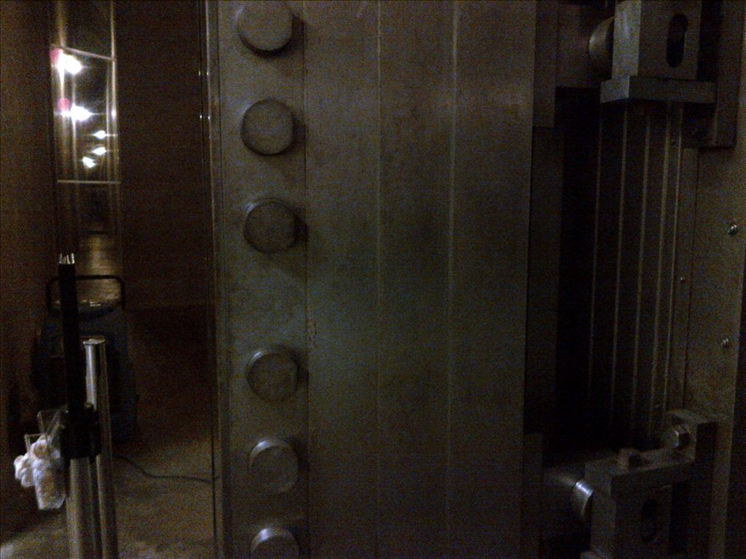

Slide 18
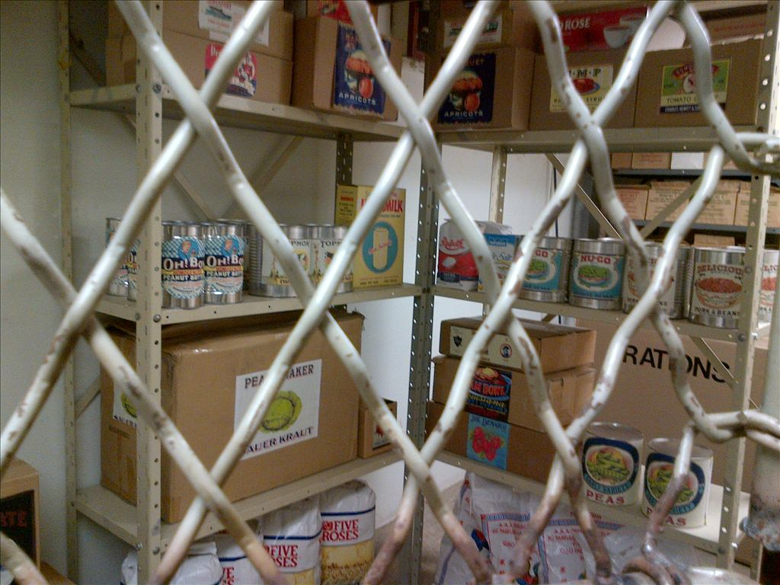
Food Storage

Slide 19
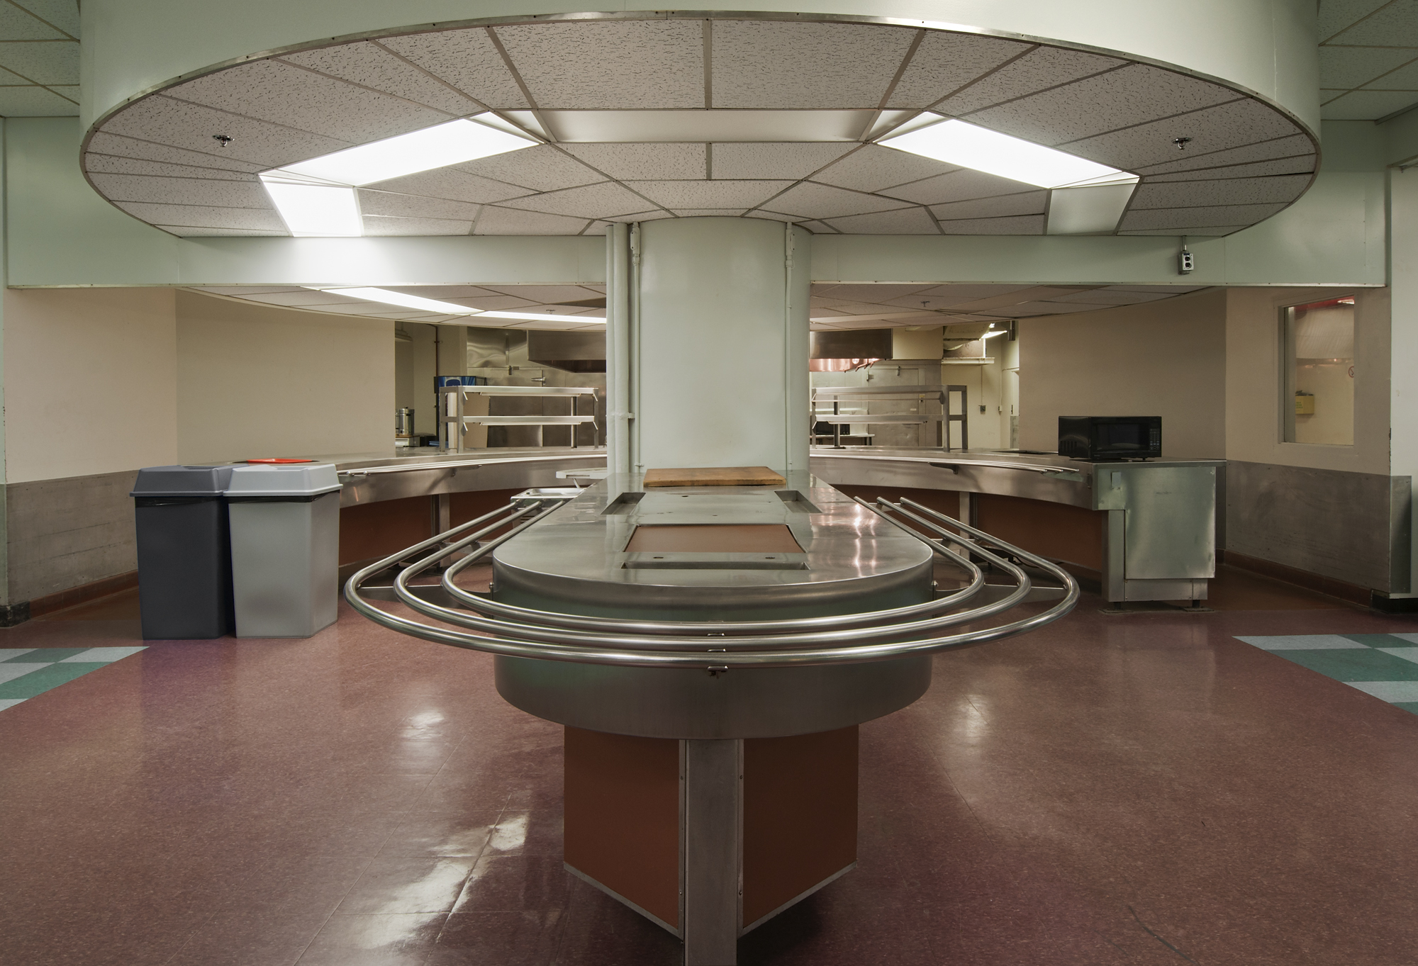

Slide 20
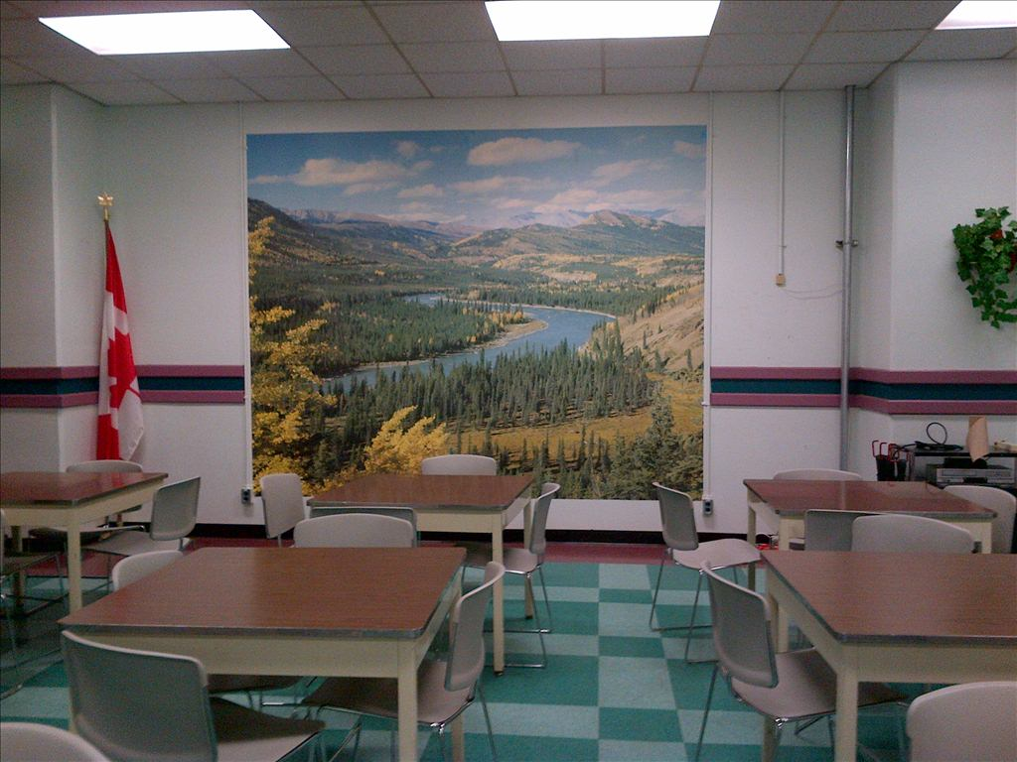
Cafeteria

Slide 21
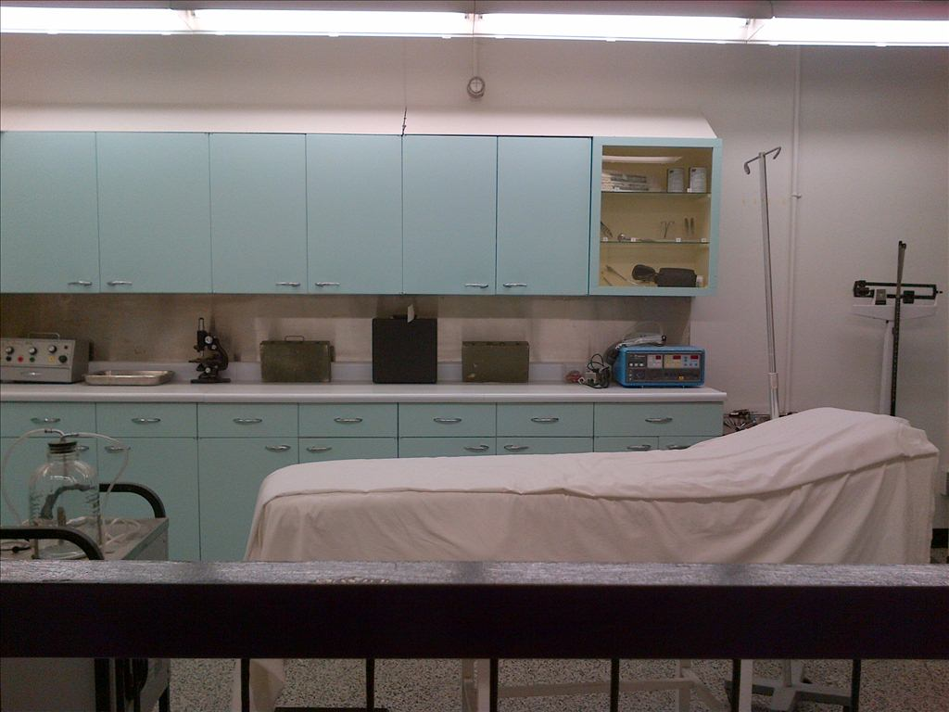
Hospital

Slide 22
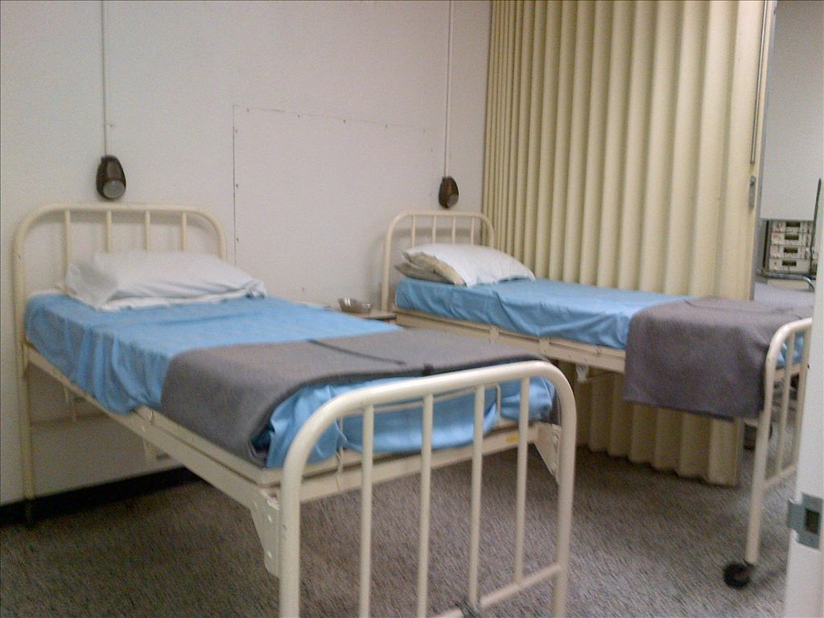
Hospital

Slide 23
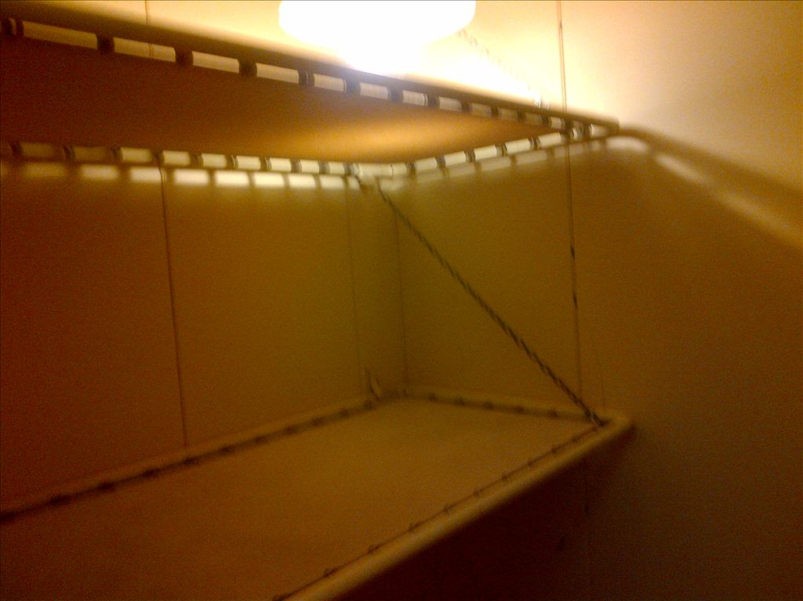
Mental Hospital

Slide 24
What can you do today at the Diefenbunker?
Get married
Have your birthday party
Attend spy camp
Watch movies
Have a meeting

