Slide 1
Creative Writing
Lesson one: Thinking outside the box

Slide 2
The Problem
Each table gets a candle, a box of thumbtacks, and a book of matches. You must attach the candle to the wall so that it does not drip onto the table/floor/counter below.

Slide 3
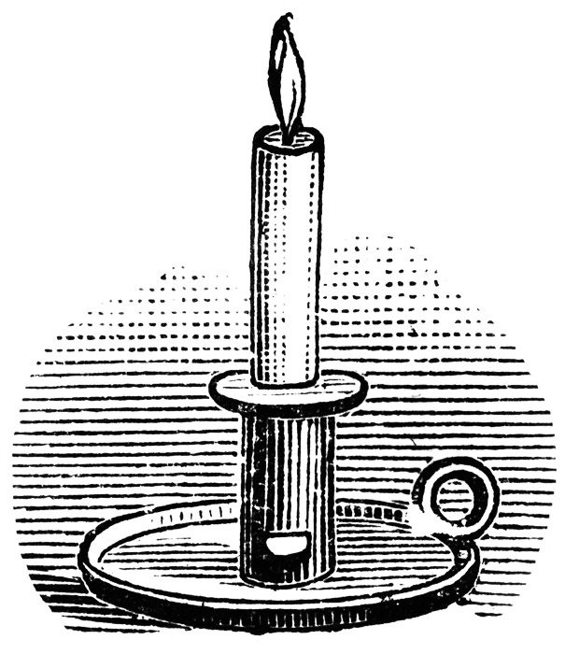
Functional Fixedness:
A cognitive bias that limits a person to using an object only in the way it is traditionally used.
When tested, 5-year-old children show no signs of functional fixedness. However, by age 7, children have acquired the tendency to treat the originally intended purpose of an object as special

Slide 4
A Functional Fixedness Example
The American Space agency NASA, wanted Astronauts to be able to write notes in space. The problem was that in space the ink in the pens doesn’t always flow to the point when there is no gravity. They eventually spent millions of dollars developing a pen which could be used upside down.
The Russian space program also had to same problem. How did they solve it? They used a pencil.

Slide 5
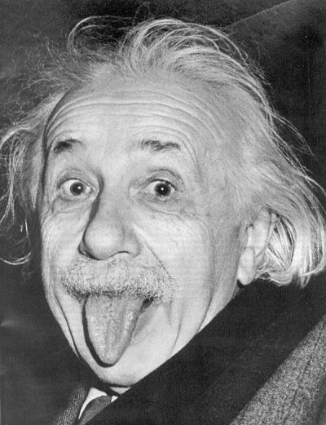
“Problems cannot be solved by the same level of thinking that created them.”
– Albert Einstein

Slide 6
“A quick thought about the disconnect between how we prepare kids for work and how work actually operates:
In school, problems almost always are clearly defined, confined to a single discipline, and have one right answer.
But in the workplace, they’re practically the opposite. Problems are usually poorly defined, multi-disciplinary, and have several possible answers, none of them perfect.” Daniel Pink

