Slide 1
Changes on France Implemented by Napoleon

Slide 2
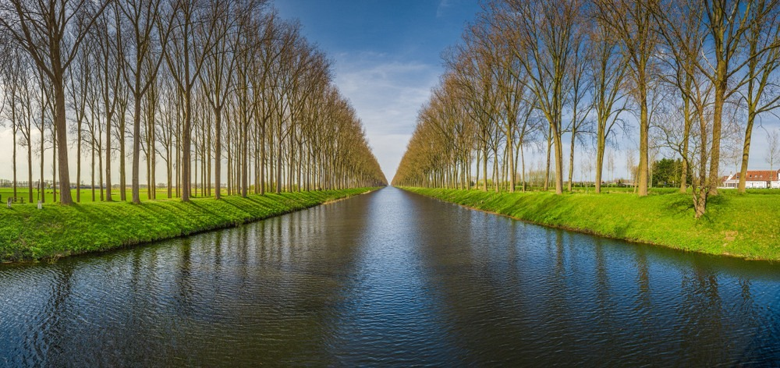
Infrastructure
-public works to fix roads for trade and so armies could move quickly
-built canals, harbors

Slide 3
Comparison of Roads
Champs-Élysées
Street in London

Slide 4
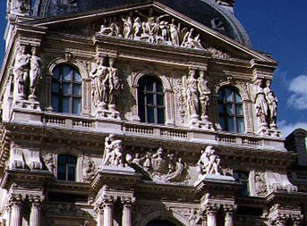
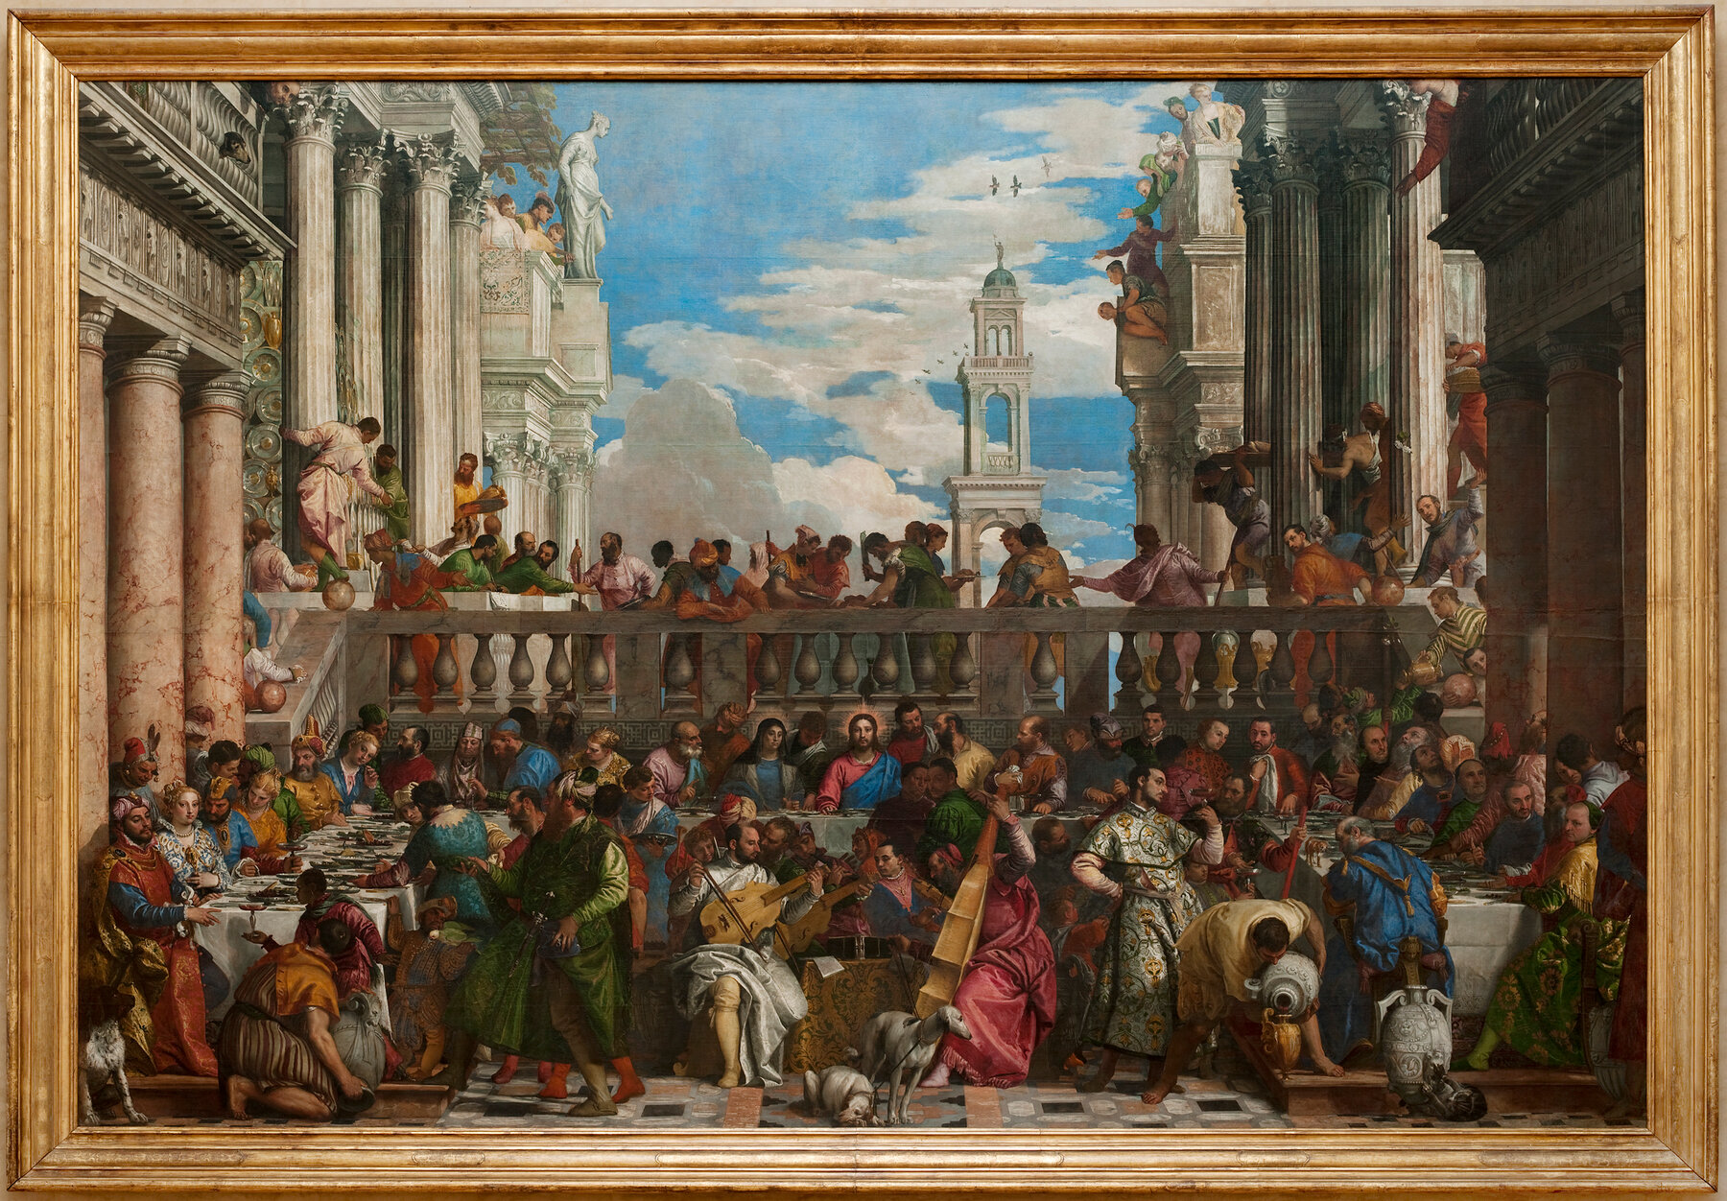
Education
-built museums, filled them with stolen art from Egypt
-new universities and school, made scholarships to allow anyone to attend, build primary and secondary schools, technical schools, parents must send children to school, against the law not to

Slide 5
Economy
-kept price of food staples low
-protected French industry from British goods by placing high tariffs on them. (however, Napoleon’s army wore British boots, only country with strong enough industry to do this)
-Made French economy seems strong, but really it was still weak, and industry was underdeveloped.

Slide 6
Law
-Unified Law Code. People equal under the law, right to hold property, freedom of religion, freedom to work where you want (our charter provides all of the same rights)
-women lost many rights.

