Slide 1
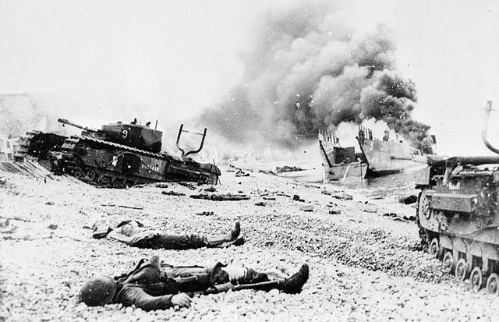
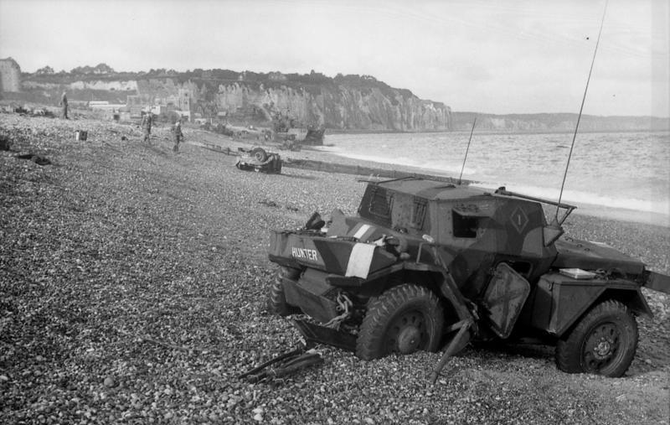
When: Middle of war 1942 August 19th
only a few hours long 5:00am - 10:50am
Where: Dieppe, France.
Beach front North coast
What: Dieppe was a war planned along
the north coast in Dieppe france
by the canadian troops.
The war was a complete suicide mission
that failed miserably.
Why: Russians put pressure on the allies
to open up the western front to help russia
because they were being bombarded by germans.
Who: 5,000 Canadians involved
907 killed
1946 taken prisoner
Reasons why the plan failed:
when the tanks came ashore they would get stuck and be unable to move due to the large pebbles on shore making it impossible for the tank to move.
There was extremely poor communication between the canadian troops on the ships
The plan was to arrive at pre dawn when they were an hour late it ruined their plan
of a surprise attack.
Canadian troops on the water ran into the german convoy ships out at sea which alerted the germans at shore letting them prepare for war.

